Slide 1
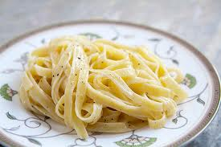
WHITE SAUCE

Slide 2
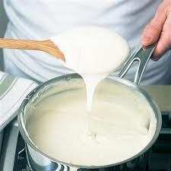
White Sauce, or cream sauce, as it is sometimes called, is a basic sauce for many cooked products. Like the basic biscuit recipe, it can be used for a variety of dishes.

Slide 3
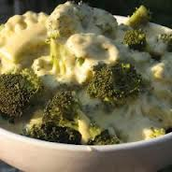
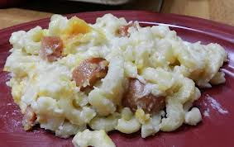
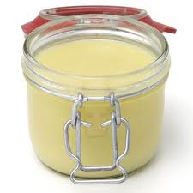
Some examples of the use of white sauce are:
Cream sauce
Macaroni and cheese
Sauce for vegetables such as broccoli and cauliflower
Sweet sauces for puddings and desserts

Slide 4
A good white sauce should be . . . . . .
Creamy white in colour
smooth– not lumpy
Slightly glossy in appearance
Make to correct consistency (e.g. thin, medium, or thick)
Nicely Seasoned with fresh flavour (no taste of starch)

Slide 5
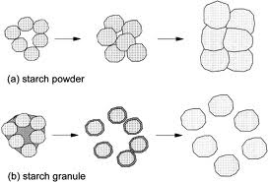
The preparation of white sauce involves two main principles:
Milk cookery
Separation of starch grains

Slide 6
The ingredients for a white sauce are:
Flour | The Thickening Agent
Fat | To separate the starch grains for the flour
Milk | The main ingredient of the sauce (the foundation)
Salt and Pepper | For flavour

Slide 7
Why separate the starch grains?
Flour is composed largely of starch – if it is added directly to milk it would not blend smoothly, but would form small lumps. This happens because the tiny starch grains of the flour have not been separated from one another and so, when the flour particles come in contact with warm liquid, they swell and stick together. For this reason, the fat is melted and mixed with the flour to separate the starch grains. When the milk is added slowly to the fat and flour mixture the ingredients blend smoothly.

