Slide 1
Water

Slide 2
Functions of Water
Transports nutrients and wastes
Lubricates joints
Regulates body temperature
Digestive, absorption, circulatory and excretory functions
You can only live about 2 days without any water – where you can go about 2 weeks without food

Slide 3
Body Composition and Water
Up to 70% of our body is water
Muscles are 75% water
Fat is 50% water
Bone is 50% water
Blood is 90% water

Slide 4
How Much a Day…?
Need 8 glasses of FLUIDS per day
If you are thirsty you are already dehydrated
Ways to tell you are dehydrated…
1. pinch finger skin
2. see colour of urine

Slide 5
Tea

Slide 6
Types of tea?
Brainstorm!
Green
Herbal
Loose leaf tea
Chai
Oolon
Milk tea
Chamomille
Lemon
Chocolate hazlenut
Orange peoke
Tension tamer
Sleepytime
Peppermint
Earl grey
Lady grey
Spiced tea
Blueberry tea
Black tea

Slide 7
Types of tea
Fall into a few categories…
Green
Black
White
Oolong
Herbal
Green, black, white and oolong are all from the same plant

Slide 8
Types of Tea Continued
Green – high concentration of polyphenol
Made from steamed tea leaves - dried and heat treated
Black – oxidized or fermented so lower concentrations of polyphenols
Made with fermented tea leaves – involves withering and rolling of the tea leaves followed by a long period of fermentation
Has the highest caffeine content of all teas

Slide 9
White – least processed of all teas
Uncured and unfermented
Tea leaves are steamed then dried
Oolong - oxidized or fermented so lower concentrations of polyphenols
After picked leaves are intentionally bruised then pan fried
Herbal
Typically made from dried fruits, herbs and flowers

Slide 10
When to add milk… or sugar
Typically only added to black teas
Can add sugar to any tea
But you don’t need it!

Slide 11
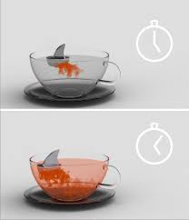
Tea Processing
http://en.wikipedia. org/wiki/File:Teapro cessing.svg

Slide 12
Health Benefits of Tea
Some teas may help with cancer, heart disease, and diabetes
Also encourage weight loss
Lower cholesterol
Bring about mental alertness

Slide 13
Health Benefits Continued
Certain type of antioxidant called a flavonoid
Fights free radicals
Green Tea contains Catechins (a type of flavonoid)
ECEG
Anticancer
Antiatherogenic
Antioxidant – protects vitamin A and D
Anti-inflammatory
Enhances immune function

Slide 14
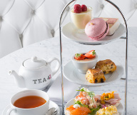
High Tea
In the olden days people only ate two meals – lunch and dinner
The Duchess of Bedford thought she was hungry mid afternoon and decided to have tea with a light snack with her friends
Can now have high tea, or afternoon tea in many fancy hotels where light sandwiches and dessert cookies and delicacies are served

Slide 15
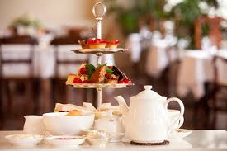
Etiquette
http://www.youtube.com/watch?v=FY9IXBGa1Os

Slide 16
Tea in China
Use one tea bag or tea leaf all day until they have gained all of the goodness from the tea leaves
Don’t want to waste those catechins or flavonoids

Slide 17
Reading Tea Leaves
1. Make your pot of tea
2. Once finished swirl your cup three times and then turn in upside down
3. See what you can see!
Handle represents you, family and friends
Going clockwise = things that have happened to you
Across the handle are people you know but not close friends
Continue clockwise = things that will happen to you in the future
Near bottom = heavy/dark
Near the brim = happy

Slide 18
Tea Reading Continued
Tea reading symbols
http://www.serenapowers.com/tealeaves.html

