Slide 1
Vegetables

Slide 2
Botanical Names for Vegetables - Parts of plant from which they come.
Tubers - potato
Bulbs - chives, onions, garlic, leeks, shallots
Roots - beets, turnips, carrot, radish
Stem - asparagus, celery, mushroom
Leaves - brussel sprouts, cabbage, chard, greens, lettuce, spinach. Watercress
Seeds - beans, peas, corn
Flowers - artichoke, cauliflower, broccoli
Fruit - cucumber, eggplant, tomato, peppers, squash

Slide 3
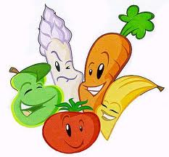
Flavors
Strong - cabbage, brussel sprouts, turnips, cauliflower onions
Mild - most all vegetables

Slide 4
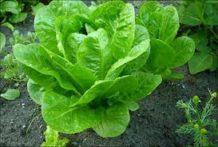
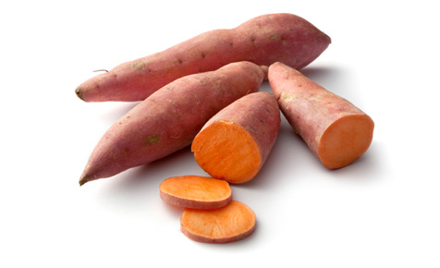
Nutrients
Water content - fruits, stems, flowers, leaves
1. tomato, celery, broccoli, lettuce - juicy and succulent
Starch - tubers, bulbs, roots, seeds
1. potato, sweet potato, lima beans, corn - starchy vegetables

Slide 5
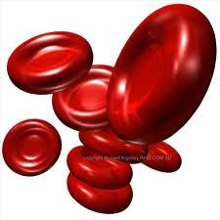
Color
Yellow - Vitamin A, B, C, calcium
White - B, C, iron, calcium
Red - A, C, thiamine, iron
Green – A,B,C Iron and Calcium

Slide 6
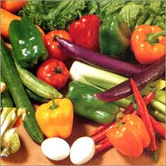
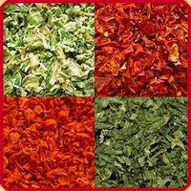
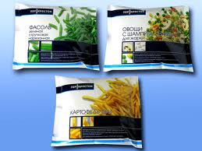
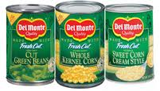
Forms
Fresh - available certain times of the year
Canned
Frozen
Dried

Slide 7
Nutrient Contribution
Vitamins
Chlorophyll - green substance of plant cells that gives their green color.
Vitamin A - eyes
Leafy green and deep yellow vegetables contain carotene which converts to Vitamin A
Vitamin C
Most vegetables contain vitamin C - broccoli, green peppers, tomatoes, cabbage
Vitamin B
Lima beans and peas

Slide 8
Nutrient Contribution Cont.
Minerals
Calcium
Iron
Carbohydrates
Cellulose, starch and sugar
Proteins
Incomplete protein - dried beans and peas

Slide 9
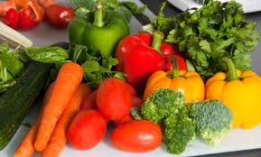
Principles of Cookery
Goal to retain color, flavor, nutrient, texture
Cellulose structure softens, and they become less crisp
Starch absorbs water, swells, and become more soluble
Water-soluble vitamins from vegetables seep out into the cooking liquid - B and C vitamins and minerals

Slide 10
Principles of Cookery cont.
Amount of water
Loss of nutrients is reduced when cooked in small amount of water
Pan is covered to prevents both scorching and loss of water due to evaporation

Slide 11
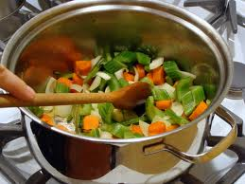
Principles of Cookery cont.
Length of Cooking Time
Vitamins are destroyed by heat and overcooking
Cook only until fork tender and still slightly crisp
Overcooking dulls the bright colors of vegetables, lose their texture and shape and become mushy
Properly cooked vegetables retain their color, flavor, and texture and nutrients

Slide 12
Method of Cookery
Boil - boil small amount of water, add vegetables, return to boil, cover pan, reduce heat to a simmer
Baked - Wash thoroughly and place on oven rack
Panned - Stir-fry, braise (fat, low heat)
Steam - Water in bottom of pan, basket to hold food, cook over boiling water
Fried - pan, deep fry, batter/crumbs
Pressure cook - quick, good flavor, color
Broil - tomato, eggplant
Microwave - retain color, flavor, texture, and nutrients

Slide 13
Selection and Buying
Canned - more water, cooked at processing time, graded by government
Fresh - more nutritious, crisp, firm, color,
Frozen - label information is your guide
Dried - beans, peas, legumes - Soak before cooking

Slide 14
How to Select Fresh Vegetables
Buy vegetables that are:
The right colour
Crisp or firm
Medium size
Solid heavy in relation to size

Slide 15
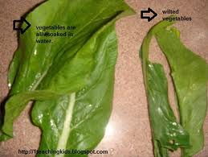
How to Select Fresh Vegetables cont.
Avoid Vegetables that are:
Wilted
Shriveled
Too small
Too large
Discoloured
Decayed.

Slide 16
Care and Storage
Refrigerate most. Examine first before putting away.
Tubers and root vegetables - store in cool, dry, dark place
Canned vegetables - on shelf at room temperature, use within a year
Frozen - use immediately when thawed

