Slide 1
Soy Products/vegetarian products

Slide 2
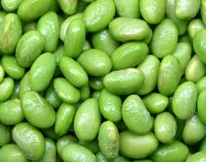
Soy beans
Native to East Asia.
Two Types:
Dry – must be soaked and cooked before eating
Green Vegetable – have to be taken out of pod then boiled for 10 minutes

Slide 3
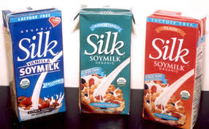
Soy Milk
A healthy, satisfying beverage for health conscious and/or lactose intolerant people. Smooth creamy texture and a mild sweetness. Made by grinding de-hulled soybeans, mixing with water and cooking. Finally the liquid is filtered and sweetened.

Slide 4
tofu
Made by curdling hot soy milk. Also known as soy bean curd. Low in Saturated fat and contains no cholesterol
Extra firm tofu – contains less water. Maintains shapes
Firm tofu – not as dense but holds shape
Soft tofu – ideal for blending into dressings and sauces, can replace yogurt or sour cream
Silken tofu – finer consistency

Slide 5
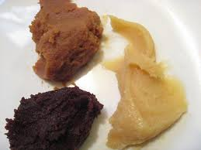
Miso
Fermented soy bean paste. Made from soybeans, rice or barley, salt and water. The paste is fermented for up to three years used to flavour soups, sauces, dressings and marinades.

Slide 6
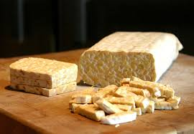
tempeh
A cake of soybeans that has been cultured. Its tender, chewy consistency makes it a versatile meat substitute. Can be grilled, deep-fried, sautéed, steamed, baked, grated, or microwaved and holds its shape very well.

Slide 7
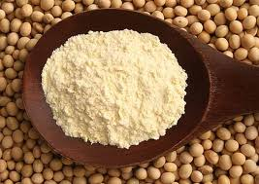
Soy flour
Rich in high quality protein and other nutrients made from roasted soybeans ground into a fine powder. Gluten free

Slide 8
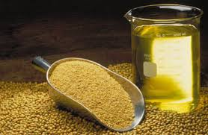
Soy bean oil
Worlds most widely used oil. Almost all margarines and shortenings contain soybean oil. Has little flavour therefore doesn’t interfere with the taste of food. Contains no cholesterol.

Slide 9
Texturized soy protein
Often called TSP, is used as a nutritious addition to many food products. Available as a dried granular product which, once rehydrated has a texture similar to ground beef. Also available in chunk-sized pieces (stew meat)

