Slide 1
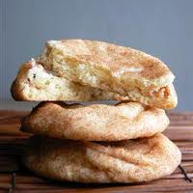
Snickerdoodles

Slide 2
Ingredients:
125ml margarine
185ml white sugar
1 egg
5ml vanilla extract
340ml all-purpose flour
5ml cream of tartar
2ml baking soda
Pinch of salt

Slide 3
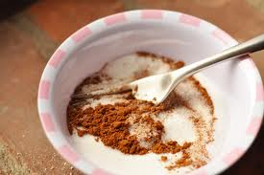
Coating Ingredients:
25ml white sugar
5ml ground cinnamon

Slide 4
Directions:
Preheat the oven to 400 degrees F
Cream together the margarine and sugar
Add the egg and vanilla, mix well
In a separate bowl, mix the flour, cream of tartar, baking soda and salt

Slide 5
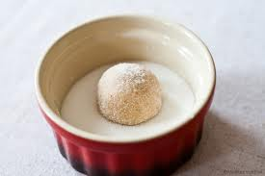
Directions Continued…
5. Add the dry ingredients to wet ingredients, mix well
6. Shape dough into equal sized balls
7. Mix the sugar and cinnamon together in a small bowl
8. Roll balls of dough in the cinnamon and sugar

Slide 6
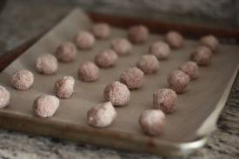
Directions Continued…
9. Place on a cookie sheet approximately 2 inches apart – do not flatten!
10. Bake for 8-10 minutes, or until edges are golden

Slide 7
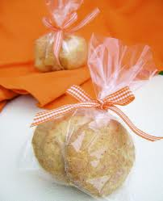
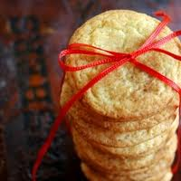
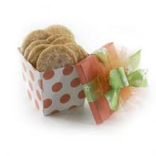
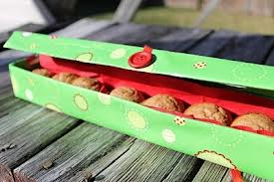
They make a good gift!

