Slide 1
REVIEW JEOPARDY

Slide 2
Question #1
Who is responsible for getting 2 dish cloths, and 2 dish towels from the back cupboard?
Answer: Dish Dryer

Slide 3
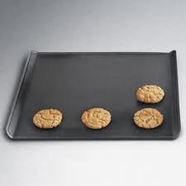
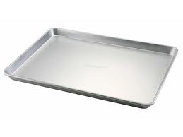
Question #2
What is the difference between a Jelly Roll pan and a cookie sheet?
A: Jelly roll pan has 4 sides that are lifted

Slide 4
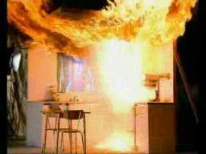
Question #3
How can we prevent Grease Fires from occurring?
A: Cook at a moderate temperature, use appropriate size pan with burner, stay attentive in the kitchen

Slide 5
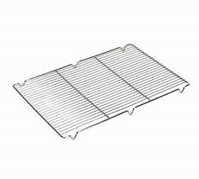
Question #4
What is the function of a cooling rack?
A: Allow air to flow freely under baked goods to increase the cooling process.

Slide 6
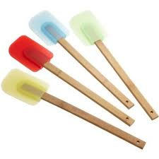
Question #5
What piece of equipment do we use to scrap the inside of bowls?
A: the rubber spatula

Slide 7
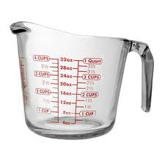
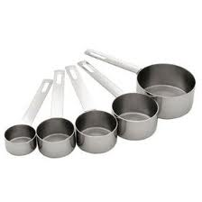
Question #6
What is the abbreviation for cup?
Answer: c.

Slide 8
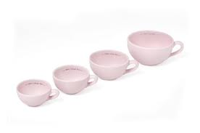
Question #7
What are the 3 sizes of dry measuring cups?
A: 50mL, 125mL, 250mL

Slide 9
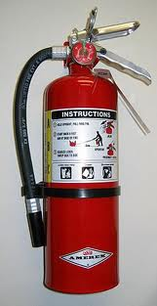
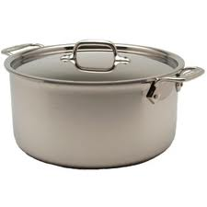
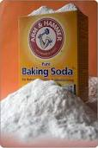
Question #8
What are two methods used to effectively put out grease fires?
A: fire extinguisher, pot lid, baking soda

Slide 10
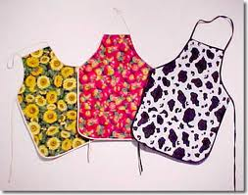
Question #9
Why do we wear an apron?
A: to protect our clothing, but also to protect our skin from splatters

Slide 11
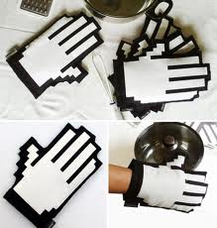
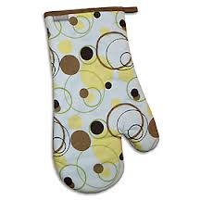
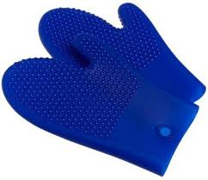
Question #10
Where are the oven mitts located?
A: D3

Slide 12
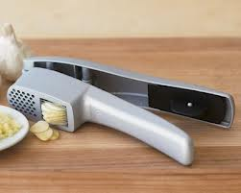
Question #10
Where is the garlic press located?
A: D1

Slide 13
Question #11
Who reports to the teacher for a job?
A: Special Duties

Slide 14
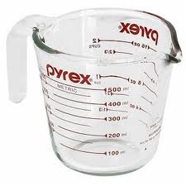
Question #12
What do we use to measure ingredients such as milk, oil and water?
A: liquid measuring cup

Slide 15
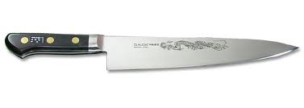
Question #13
How do we walk with knives?
A: Blade pointed downwards and sharp sides towards the back of you.

Slide 16
Question #14
If a fire breaks out in a pot on the stove, what should you do?
A: contain it there, do not attempt to move the pot

Slide 17
Question #15
Who is responsible for collecting all the ingredients from the supply table for their entire unit?
A: Unit House Keeper

Slide 18
Tie Breaker
In what order do we wash dishes? (I am looking for 5 different types of dishes)
A: Glasses, Cutlery, China, Cooking Utensils, saucepans (soaking)

