Slide 1
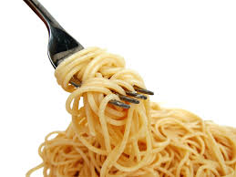
Pasta

Slide 2
Types of NOODLE
Penne
Spaghetti
Fettuccine
Lasagne
Linguini
Ravioli
Rigatoni
Macaroni
Gnocchi
Canneloni
Rotini
Spechtla
Farfalle
Tortellini
Fusilli
Vermacelli
Soba
Udon
Manicotti
Spirai
Corzetti
Ziti
Angel hair

Slide 3
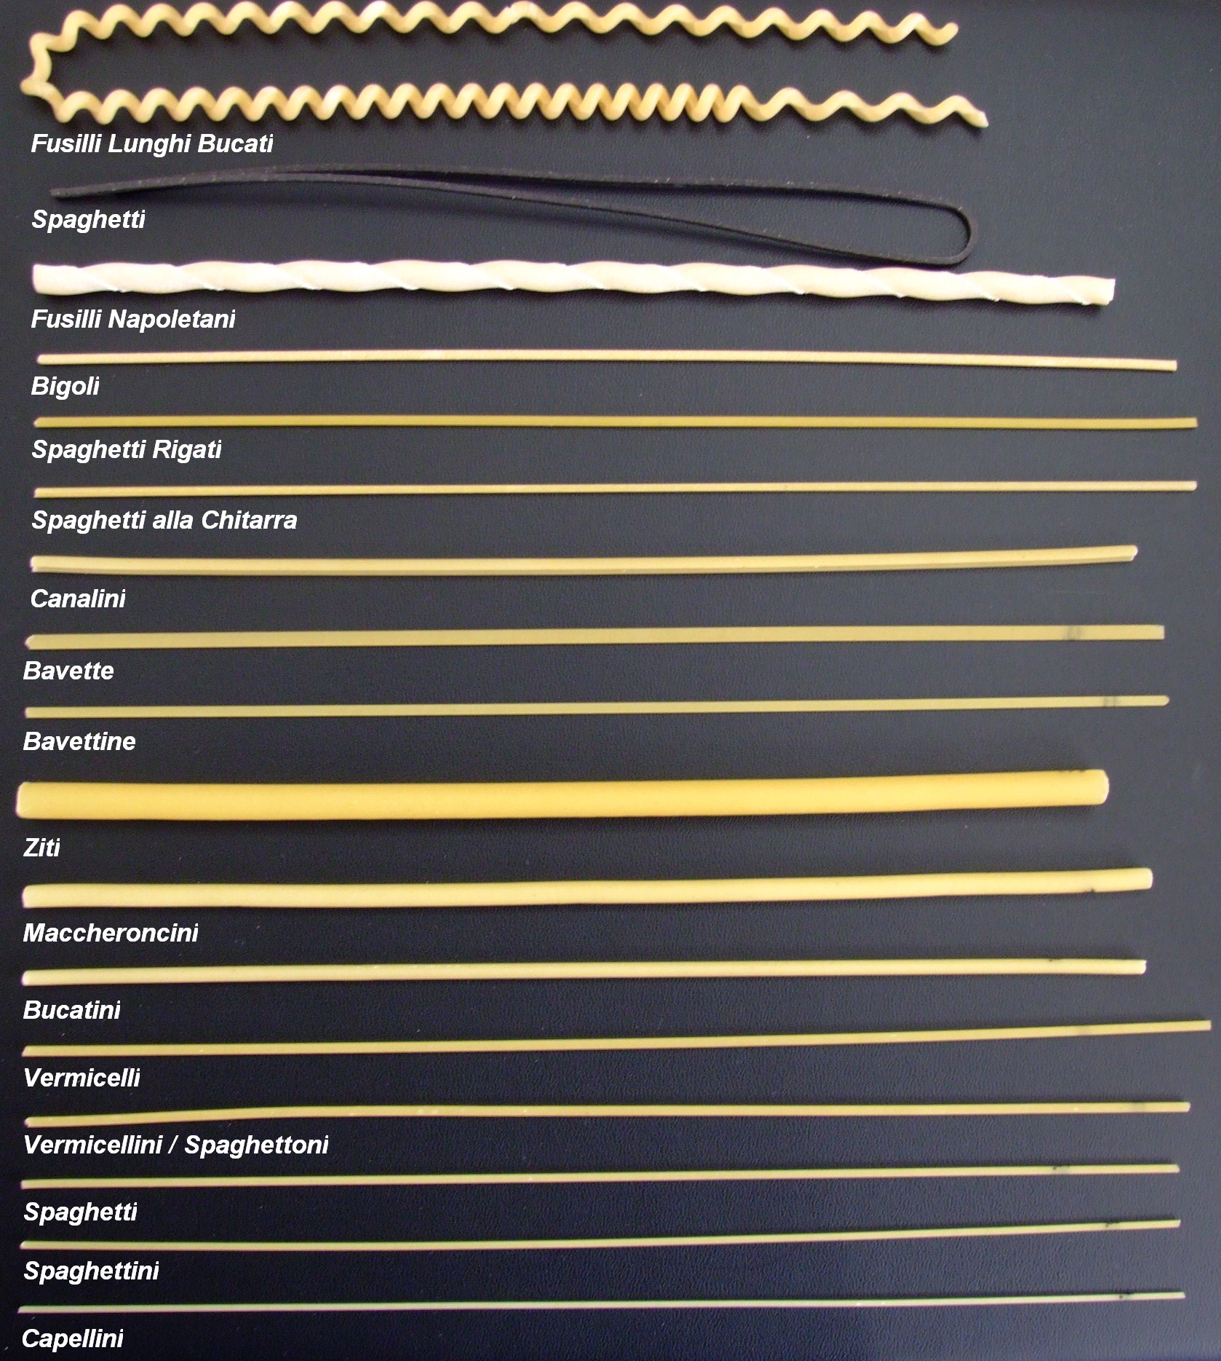

Slide 4
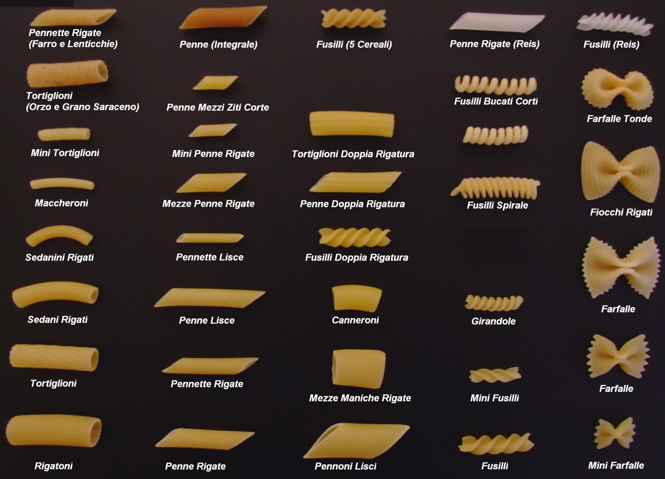

Slide 5
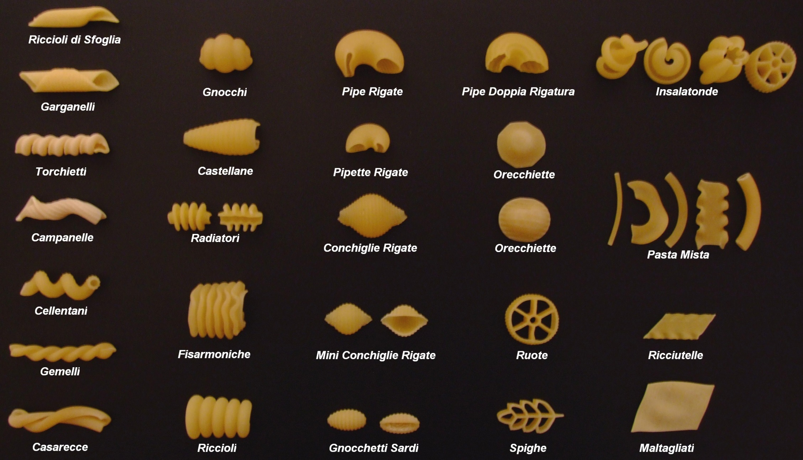

Slide 6
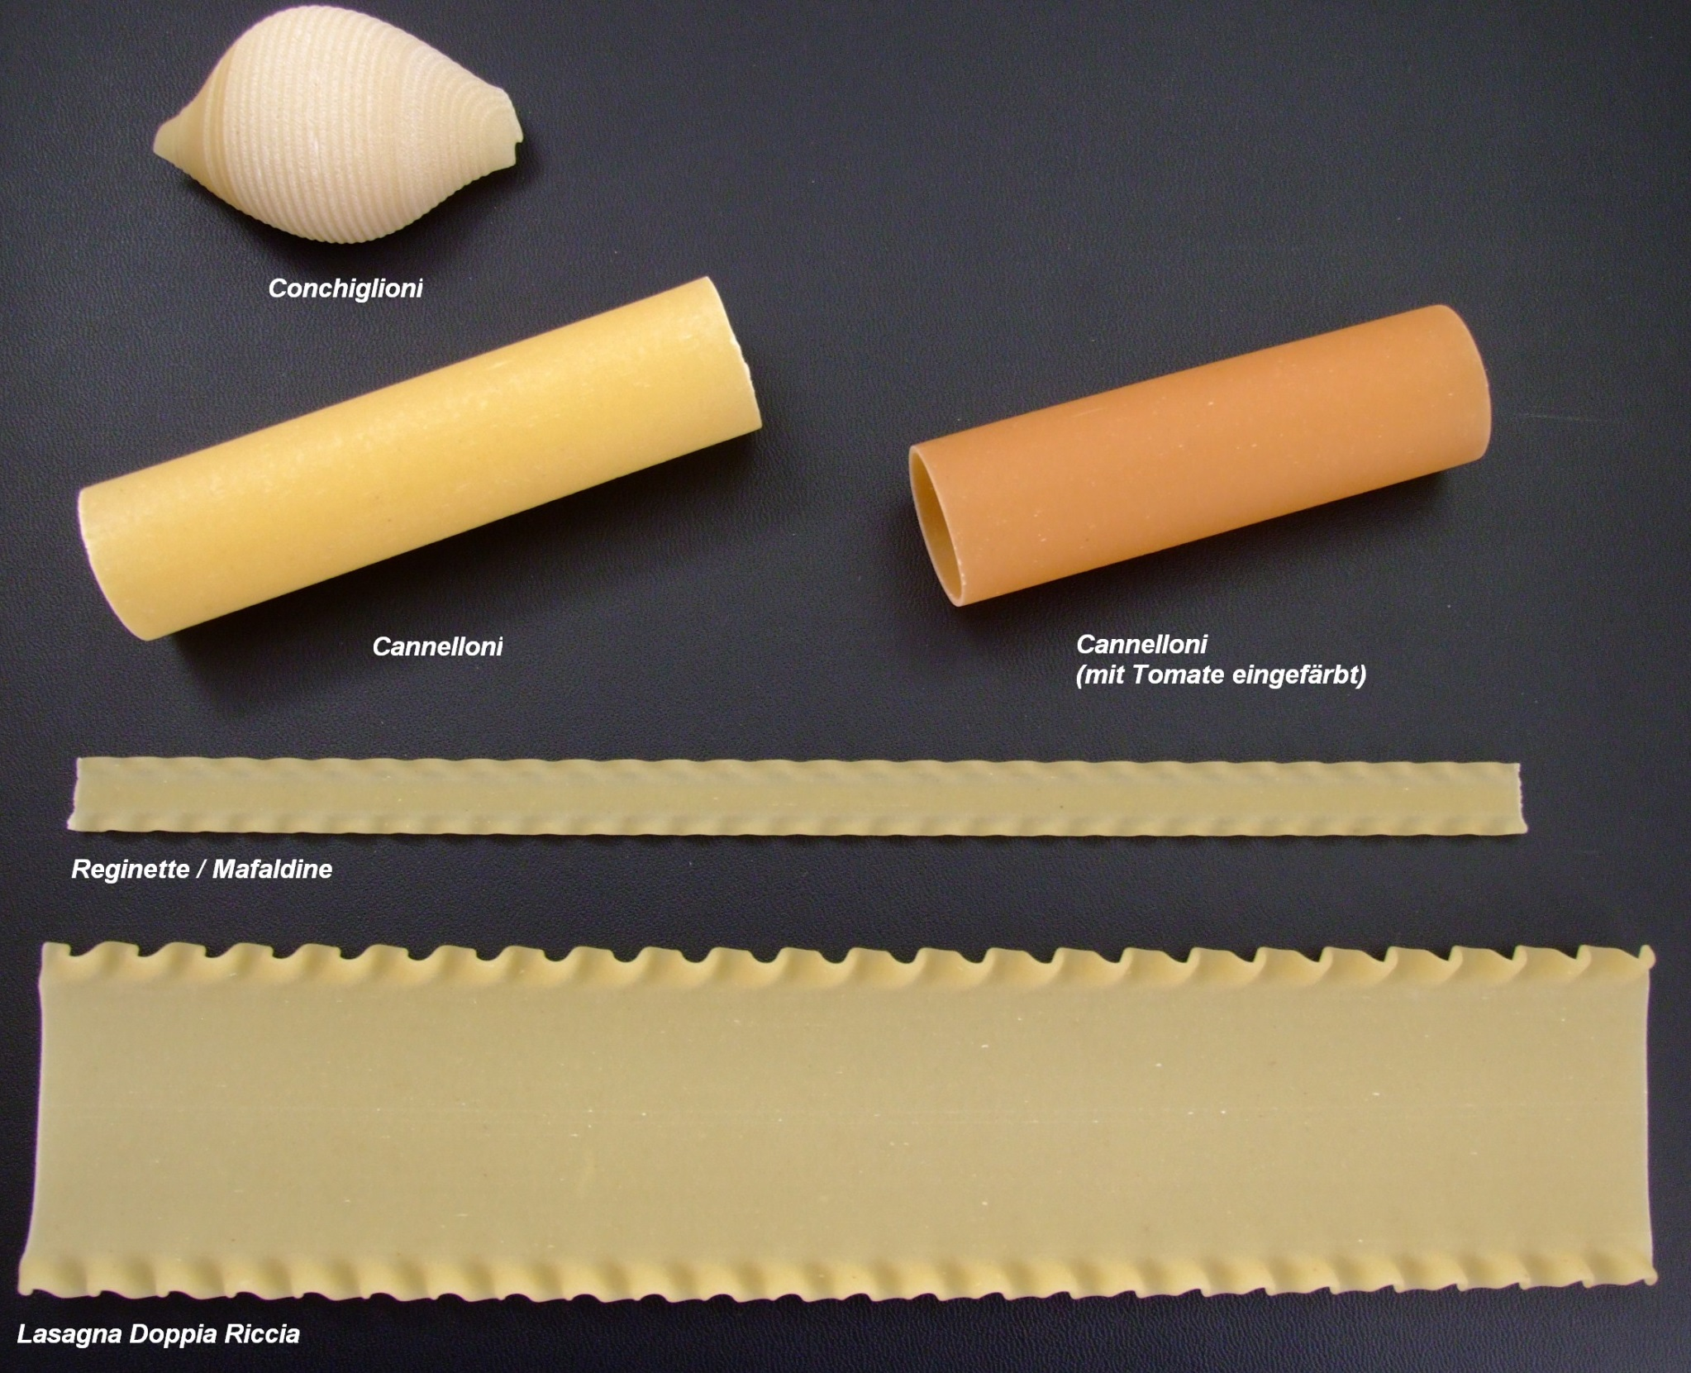

Slide 7
Noodle Names Explained…
Elli, etti, illi, ini, ine, elle = mean little or small
Oni, one, otti = mean large
Acci = rough or badly made
Examples:
Spaghetti = normal
Spaghettini = small spaghetti
Spaghettoni = large spaghetti

Slide 8
Pasta SAUCES
Meat sauce
Pesto sauce – green sauce
Alfredo sauce – white sauce
Red sauce
Rose
White sauce
Cheese sauce
Tomato sauce - Marinara sauce
Bolognese – meat sauce
Carbonara sauce -
Puttenesca

Slide 9
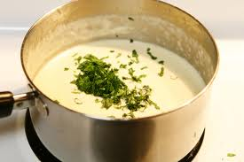
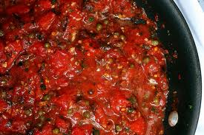
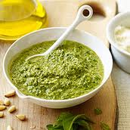
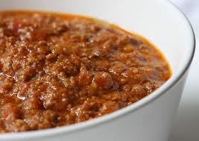
Sauces

Slide 10
Where did Pasta come from?
What we think of “pasta” if from Italy
Debate to whether or not Marco Polo discovered pasta in China on his travels and brought it back to Europe
Many Asian countries and other European countries do their own “version of pasta” with a noodle made of a flour, egg and water which is where the confusion comes from
Italians tend to get the glory due to their creativity in making pasta shapes (over 350 different ones) and delicious recipes

Slide 11
Pasta Shapes…
Different shapes are important in what you want the noodle to do…
Lasagne stacks nicely
Tubes and interesting shapes have ridges to cling to sauce or can be filled
Flatter and longer shapes pair with olive oil based sauces to keep noodles separate without drowning the noodle
Delicate noodles cant support meat sauce
Important terminology
Extrusion → the process of forcing a pasta dough through a (die) machine of proper shape and cut to size

Slide 12
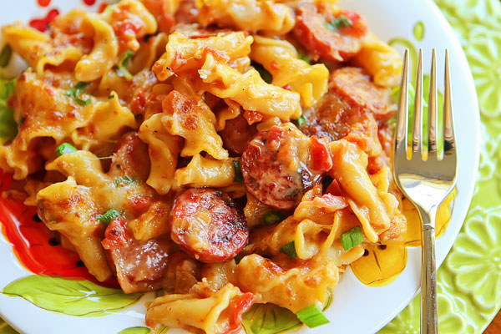
Modern Pasta
It is estimated that Italians eat over 60lbs of pasta per person per year – beating Americans who eat about 20lbs
While you can still get traditional pasta types and varieties there have also been many new creative additions to the pasta family

Slide 13
Serving Sizes
If you have a scale 1 measure is considered 57g or 2 oz
Long noodles – about a 1 inch diameter between thumb and forefinger (about a quarter size around)
Small shapes – macaroni – half cup measure
Larger shapes – penne – ¾ cup measure

Slide 14
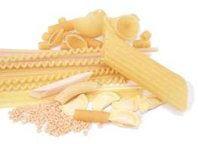
Dried Noodles
Storage
Have an expiration date on the box
Is good until that date if stored in a dry, sealed container
Note: if the pasta is whole grains or high fiber the best before date will be much sooner than pasta without whole grains
Once cooked pasta can store in a sealed container in the fridge for about a week or can be frozen for about 6 months

Slide 15
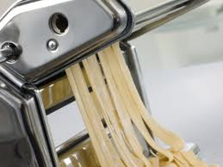
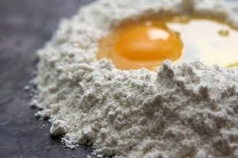
Fresh Noodles
Can be made with different ingredients than dried – for example using different flour for gluten intolerant
Storage
Best if you make the dough and pasta to eat on the same day
Once cooked it can be stored for about a week same as dried pasta or frozen the same after cooked
If you are just keeping the noodles 2-3 days sealed in the fridge
Takes less time to cook than dried

Slide 16
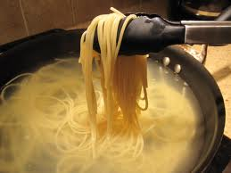
Cooking Pasta
Important tips:
Bring water to boil before adding pasta
Add salt to water – helps flavour and causes the water to boil HOTTER = faster cooking time
Use LOTS of water and LARGE pot or pasta will stick together
Some people use oil – but if you have a big enough pot this isn’t necessary and can actually PREVENT sauce from sticking to the noodles later

Slide 17
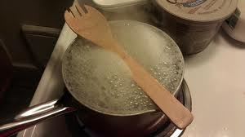
Cooking Pasta Continued…
Put a cool wooden spoon over the pot to prevent water from boiling over – this bursts the bubbles rising up but once its heated up this stops working so blow on the pot instead
Do NOT rinse noodles after draining – rinsing removes starch and takes away any flavour the noodles had from boiling in salty water
http://www.youtube.com/watch?v=slLGniM_mJA
Terminology:
Al dente → tender but firm to the bite (middle should still have a little colour to it)

Slide 18
Nutrients in Pasta
GRAINS = CARBOHYDRATES
Carbs are supposed to be 40-60% of your daily intake of calories
Good for energy
Whole wheat pasta = fiber
Fiber helps remove LDL cholesterol from your body and keeps your system smooth
Dependent on the sauce you put on
Lots of sauce = a lot of fat from butter

Slide 19
Health Tip
Use less sauce
Don’t have pasta all the time = MODERATION
At restaurants don’t eat the whole portion, bring home a to go bag
Add vegetables to your pasta to increase other vitamins and minerals

