Slide 1
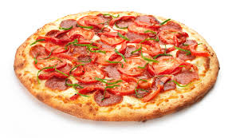
Nutrients in Pizza

Slide 2
What is a macronutrient? Name all three.
A macronutrient is a chemical compound that humans consume in large quantities
Fat (20-35%)
Protein (10-35%)
Carbohydrates (45-65%)

Slide 3
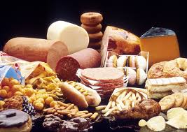
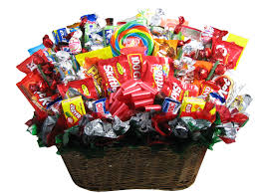
Give an example of each macronutrient and explain what each does in the body.
Fat – fish, meat, oil, butter, some vegetables (avocado), junk food
Insulates, protects organs, helps nerve transmission, helps body absorb fat soluble vitamins, energy storage

Slide 4
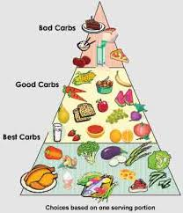
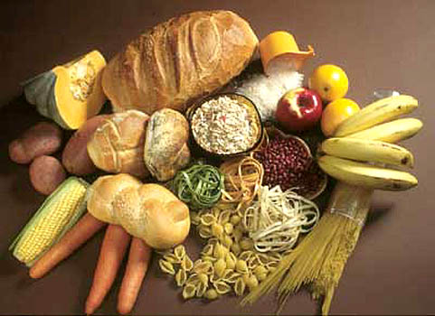
Give an example of each macronutrient and explain what each does in the body.
Carbohydrate – anything with sugar and/or fiber (breads, grains, fruits, vegetables, candy… etc…)
Provides your body with it’s main source of energy

Slide 5
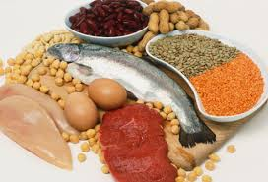
Give an example of each macronutrient and explain what each does in the body.
Protein – anything made up of amino acids (meat, nuts, seeds, legumes)
Helps build and repair tissues

Slide 6
What is a micronutrient? Name all two.
A micronutrient is a chemical compound that the human body needs in small quantities
Vitamins
Minerals

Slide 7
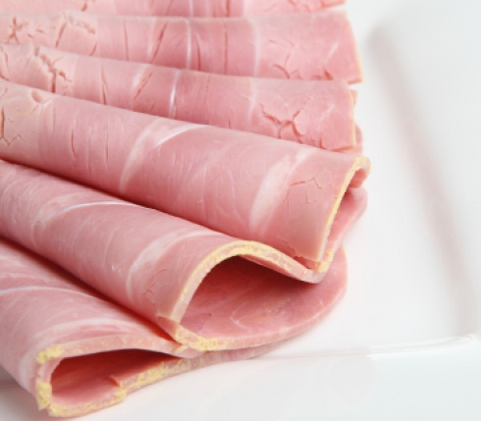
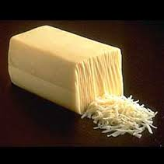
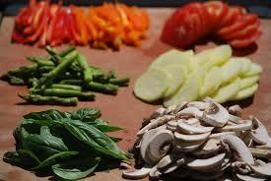
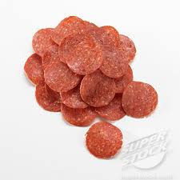
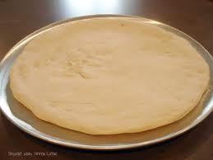
What are examples of macronutrients in your pizza?
Fat
Mozzarella cheese
Pepperoni
Ham
Carbohydrates
Pizza crust
Vegetables
Protein
Mozzarella cheese
Pepperoni
Ham

Slide 8
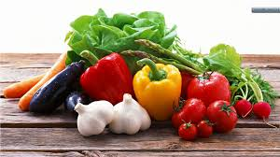
What are examples of micronutrients in your pizza?
Vitamins and Minerals
EVERYTHING but higher quantities and less macronutrients in the vegetables

Slide 9
What are the specific micronutrients you get from each ingredient in your pizza? And what does each do for your body?
All possible ingredients:
Pizza crust
Flour
Salt
Yeast
Sugar
Tomato sauce
Mozzarella cheese
Pepperoni
Ham
Green pepper
Pineapple
Onion
Mushrooms
Broccoli rabe
Olives
Tomato

Slide 10
Vitamins (fat soluble)
Micronutrient | What the micronutrient does in the body | Pizza ingredients that contain this micronutrient
Vitamin A | Prevents eye problems Promotes healthy immune function Keeps skin healthy https://www.google.ca/search?q=xerophthalmia&rlz=1C1TSCD_enCA456CA456&espv=210&es_sm=93&source=lnms&tbm=isch&sa=X&ei=AVsKU_P1FcHmoASn2oDIBw&ved=0CAkQ_AUoAQ&biw=667&bih=615 | Tomato sauce Mozzarella cheese Green pepper Broccoli rabe Tomato
Vitamin E | Antioxidant Protects cells from damage Aids red blood cell health | Broccoli rabe Tomato

Slide 11
Vitamins (fat soluble)
Micronutrient | What the micronutrient does in the body | Pizza ingredients that contain this micronutrient
Vitamin D | Strengthens bones because it helps the body absorb calcium https://www.google.ca/search?q=xerophthalmia&rlz=1C1TSCD_enCA456CA456&espv=210&es_sm=93&source=lnms&tbm=isch&sa=X&ei=AVsKU_P1FcHmoASn2oDIBw&ved=0CAkQ_AUoAQ&biw=667&bih=615#q=vitamin+d+deficiency&tbm=isch | Mushrooms
Vitamin K | Helps blood clot | Broccoli rabe

Slide 12
Vitamins (water soluble)
Micronutrient | What the micronutrient does in the body | Pizza ingredients that contain this micronutrient
Vitamin C | Needed to form collagen Essential for healthy bones, teeth, gums and blood vessels Helps the body absorb iron Aids in wound healthy Contributes to brain function http://www.youtube.com/watch?v=OXXwF_LvNfI | Tomato sauce Green pepper Pineapple Onion Broccoli rabe Tomato
Vitamin B6 | Important for normal brain and nerve function Helps the body break down proteins and make red blood cells | Flour (in crust) Pepperoni Ham Broccoli rabe

Slide 13
Vitamins (water soluble)
Micronutrient | What the micronutrient does in the body | Pizza ingredients that contain this micronutrient
Vitamin B12 | Helps make red blood cells Important for nerve cell function | Mozzarella cheese Pepperoni Ham
Vitamin B9 (folic acid) | Needed to make DNA Prevents brain damage in pregnancy | Yeast Broccoli rabe

Slide 14
Vitamins (water soluble)
Micronutrient | What the micronutrient does in the body | Pizza ingredients that contain this micronutrient
Vitamin B3 (niacin) | Helps the body turn food into energy Helps maintain healthy skin and important for nerve function | Pepperoni Ham Mushrooms
Vitamin B1 (thaimine) | Helps the body convert carbs into energy Helps the heart, muscles and nervous system to function properly | Flour

Slide 15
Vitamins (water soluble)
Micronutrient | What the micronutrient does in the body | Pizza ingredients that contain this micronutrient
Vitamin B2 (riboflavin) | Essential for growth Produces energy from food Red blood cell creation | Mozzarella cheese Mushrooms Broccoli rabe
Vitamin B5 (pantothenic aicd) | Converts food to energy Makes hormones Helps immune function | Broccoli rabe Mushrooms
Vitamin B7 (biotin) | Converts food to energy Gives healthy skin, hair and nails | Broccoli rabe

Slide 16
Minerals (major)
Micronutrient | What the micronutrient does in the body | Pizza ingredients that contain this micronutrient
Sodium | Maintain blood pressure and fluid balance Normal nerve and muscle function | Salt (in crust) Pepperoni Ham Olives
Calcium | Maintains healthy bones and teeth Needed for muscle and nerve function Release of hormones and enzymes | Mozzarella cheese Broccoli rabe
Potassium | Helps heart function Reduces cholesterol | Yeast (in crust) Tomato sauce Mushrooms

Slide 17
Minerals (trace)
Micronutrient | What the micronutrient does in the body | Pizza ingredients that contain this micronutrient
Iron | Carries oxygen in red blood cells as a part of haemoglobin | Mushrooms Broccoli rabe Olives
Iodine | Makes thyroid hormones to control metabolism | Salt

Slide 18
Watch “For a Few Pennies More”
video on IODINE
http://www.youtube.com/watch?v=NV4X5cXaf7Y

Slide 19
Reflection questions…
What was the reason these people did not get iodine? Do you think that is okay? Why?
Do you think that this is an issue in Canada? Why or why not?
How did the video make you feel? Why do you think that is?
Did you know that micronutrients played such an important role in the body? Do you think you are lacking any? Why? How can you tell?
Do you think it is okay that this is going on in other areas of the world? What can we do about it?

