Slide 1
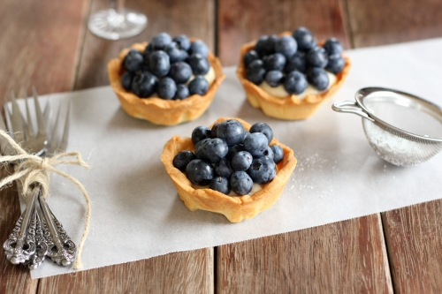
Little Blueberry Tarts!
{ The yummiest little dessert you
ever did have!

Slide 2
Equipment:
You will need:
Medium Size Bowl
Large Size Bowl
Measuring Cups – dry and liquid
Measuring Spoons
2 Mixing Spoons
Whisk
Plastic Wrap
Medium Saucepan
Rolling Pin
6 Hole Muffin Tin
Rolling Pin
Cookie Cutter

Slide 3
Ingredients:
You will need:
Pastry
40ml icing sugar
125ml flour
100ml cold cubed butter
1 egg yolk
Custard
150ml milk
50ml sugar
15ml flour
2ml cornstarch
1ml salt
2 egg yolks
5ml vanilla
Topping
125ml fresh blueberries

Slide 4
WE AREGOING TO BE DOING THIS OVER 2 DAYS
Day #1:
Pastry
Custard
Day #2:
Putting it all Together - makes 6 tarts

Slide 5
Step #1: The Pastry
1. Mix icing sugar, flour and butter until the mixture resembles breadcrumbs
2. Add the egg yolk and mix until a dough forms
3. Shape dough into a disc
4. Wrap in plastic wrap
5. Label your dough by writing your name on tape and putting it on dough
6. Put in fridge

Slide 6
Step #2: The Custard
1. Pour milk into saucepan
2. Scald the milk – heat until bubbles appear around the edges but does NOT boil
3. In a small bowl, mix sugar, flour, cornstarch and salt
4. In a medium bowl whisk together the egg yolks and the vanilla
5. Whisk the flour mixture into the egg yolks SLOWLY – it will be thick and pasty
6. Once milk is heated slowly pour it into the egg mixture, whisking continuously
7. Once incorporated pour it back into the saucepan and heat on a MEDIUM heat until it comes to a boil
8. When bubbles appear mix vigorously for 10seconds then turn off the heat
9. Pour into the medium size bowl and let cool 5 minutes
10. Cover with plastic wrap and label, then put in the fridge

Slide 7
Step #3: Putting it all Together
1. Preheat oven to 160 degrees C
2. Grease 6 hole muffin tin
3. Get your dough
4. On a lightly floured surface roll out your dough
5. Use a cookie cutter to make 6 rounds
6. Line your muffin holes with rounds – pressing them into the edges
7. Bake tart shells for 8-10 minutes or until golden
8. Cool completely on wire rack (about 5 minuets) then remove shells
9. Get custard cream from fridge – divide evenly into shells
10. Arrange blueberries on top

