Slide 1
Kitchen Equipment
Everything that you are going to be using in Food and Nutrition – what it does and where you can find it!

Slide 2
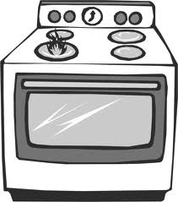
OVEN
Function:
Use to bake, broil, heat up dishes
Convection ovens – heat is moved around oven
In units of degrees Celsius or Fahrenheit
One in each unit

Slide 3
STOVE
Function:
Convection system of pan directly on heated surface
Used for frying, sauteeing, boiling, etc…
Most have 4 elements – it is important to turn on the correct element that you are using and only turn it on when you have a pot/pan on that element (not before)
Heat is in units of 1-10 usually 10 being high – depends on recipe what you use – boiling = 10, simmer = 1-2
1 stove in each unit

Slide 4
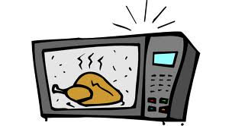
MICROWAVE
Function:
Heat up food using heat waves
Don’t put metal in microwave
Wont be using them often unless margarine needs to be melted

Slide 5
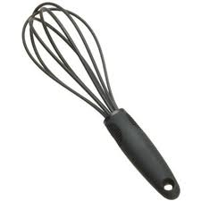
WHISK
Function:
Used to whip mixtures – such as egg whites to make meringues or sauces to take out lumps
Wont be using this too often

Slide 6
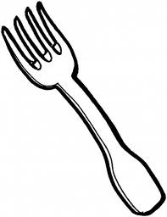
FORKS
Function:
Can be used similar to a whisk to mix sauces
Used to mash some items like a banana
Used to deliver food from a plate to your mouth

Slide 7
SPOON
Function:
To get liquids from bowl to your mouth
To put spoonful amounts of ingredients into mixtures
Used for mixing

Slide 8
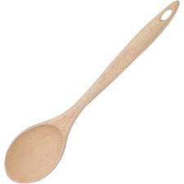
MIXING SPOON
Function:
Wooden spoon used for mixing
Will be using this frequently with our flour mixtures
Why wooden spoon – sturdy, wont bend/break and its bigger and easier to hold on to for mixing

Slide 9
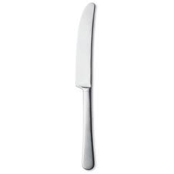
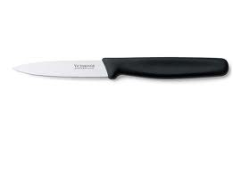
KNIVES
Function:
Table knife – spreading or cutting small, soft things
Paring knife – used to peel and cut veggies and fruits
Chefs knife – chopping vegetables, meat, etc
Much bigger than the others
Similar to this is the utility knife which is a smaller version

Slide 10
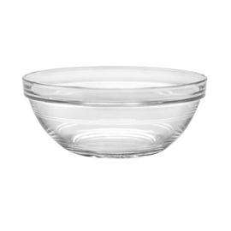
BOWLS
Function:
To hold the mixture you are creating
Have different sizes – small, medium and large
Glass = they get hot and can break

Slide 11
LEVELLER
Function:
To smooth out dry ingredients in measuring cups/spoons so that the measurement is accurate
Will be used often

Slide 12
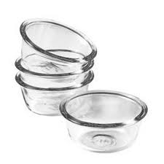
CUSTARD CUPS
Function:
Hold small amounts of ingredients
Bring them up to the front during labs to measure ingredients into for transport
Different sizes
Will use often
Found in measuring tray in cupboard #6

Slide 13
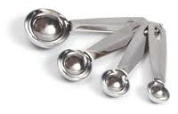
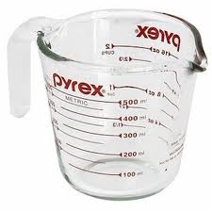
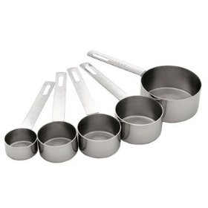
MEASURES
Function:
Measuring spoons – to measure small amounts of dry ingredients
Measuring cups – to measure larger amounts of dry ingredients
Liquid measure – to measure liquid ingredients

Slide 14
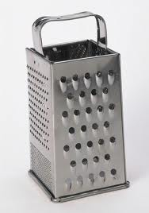
GRATERS
Function:
To grate ingredients into smaller pieces – usually used for cheese
Different sized grates for big pieces, small pieces and slices
Ours have a catching cup

Slide 15
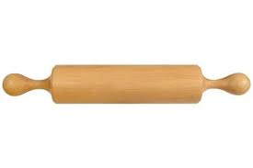
ROLLING PIN
Function:
Roll out dough to be cut into shapes
Important to flour rolling pin so it doesn’t stick to dough

Slide 16
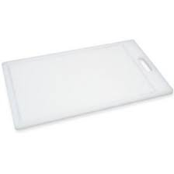
CUTTING BOARD
Function:
Protect counter tops
Provide surface for cutting
Found in drawer #3

Slide 17
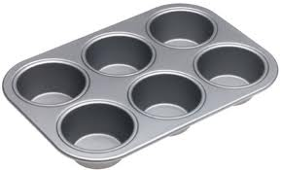
MUFFIN TIN
Function:
To make muffins/cupcakes

Slide 18
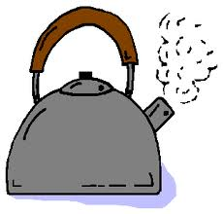
KETTLE
Function:
To boil water
Different types – stove top or electric

Slide 19
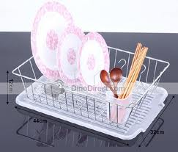
DISH RACK AND DRIP PAD
Function:
Hold dishes to dry
Drip tray – allows water to drip from dishes and get collected in the sick instead of the counter
Under the sink

Slide 20
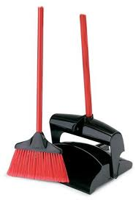
BROOM AND DUST PAN
Function:
To sweep up messes made on the floor
Dustpan collects items and garbage to put into the garbage can
Found in the back right corner of the class

Slide 21
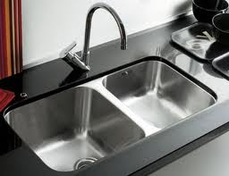
SINK
Function:
To wash hands and dishes in
Use plugs to contain water when washing dishes
Has a hot and cold faucet
Found in each unit

Slide 22
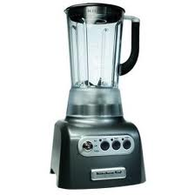
BLENDER
Function:
To mix, blend, crush, puree items put into it to make smoothies, purees, etc
Some have heating functions to make soups
Wont be using them much

Slide 23
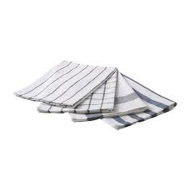
TOWELS
Function:
Small towels – for washing dishes
Large towels – for drying dishes
Found in the back
Get cleaned in the back washer and dryer frequently – could be special duties job to fold

Slide 24
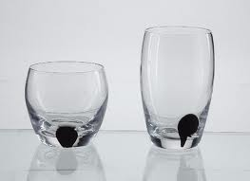
CUPS
Function:
To hold liquid for drinking
In different sizes depending on the drink

Slide 25
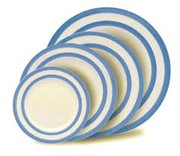
PLATES
Function:
Hold prepared meal items for serving
Different sizes for dinner, snack, serving

Slide 26
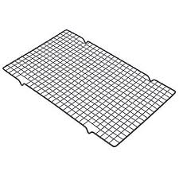
COOLING RACK
Function:
Used to hold hot items that come out of the oven
Allow air flow to cool items quickly

Slide 27
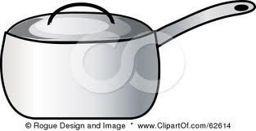
POTS
Function
Used to boil noodles or make soups
Hold larger amounts of liquids
Different sizes based on what you are making
Metal = can use metal spoons in them

Slide 28
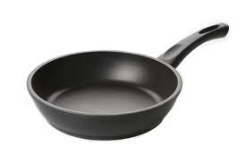
FRYING PANS
Function:
Go on stovetop to cook ingredients by frying, sauteeing, etc
Teflon = don’t use metal in them or it will scrap off the protective teflon – use plastic
Different sizes

Slide 29
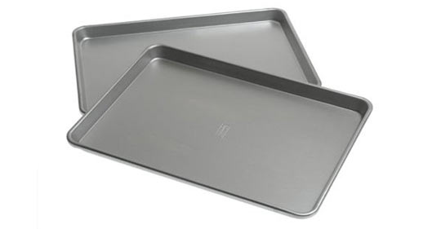
BAKING SHEET
Function:
Bake cookies, bars, etc
Flat surface to go into oven
Line with parchment paper to save the sheet

Slide 30
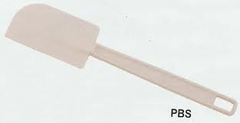
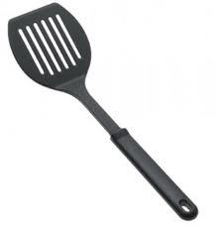
SPATULA
Two types…
1: top – spatula used to scrape batter from a bowl to keep sides of bowl clean
1: bottom – spatula also known as a flipper – used to flip items such as pancakes or mix foods in a frying pan

Slide 31
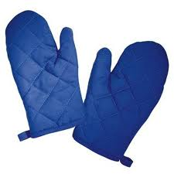
OVEN MITTS
Function:
Lined to protect hands from hot items
Use when moving items from the oven or stove

Slide 32
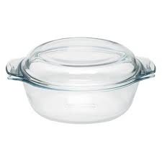
CASSEROLE DISH AND LID
Function:
To hold casseroles/pastas
Used in the oven and to serve food out of
Can cook with lid on or off

Slide 33
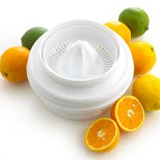
JUICER
Function:
To collect juice from fruits such as lemons, limes or oranges
Other automatic juices can juice other fruits and vegetables
Will not be using

Slide 34
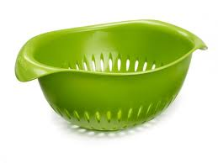
COLANDER
Function:
To strain items cooked it water such as pasta

Slide 35
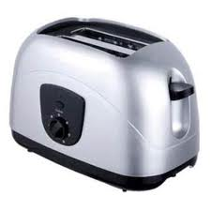
TOASTER
Function:
SAY POST 10 TIMES – FAST!
WHAT DO YOU PUT IN A TOASTER?
BREAD!
A small kitchen appliance designed to toast different types of bread products

Slide 36
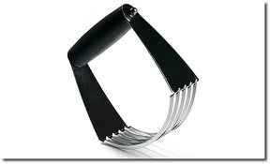
PASTRY CUTTER
Function:
To blend a hard fat into a flour mixture in baked goods such as biscuits
Used by pressing the blades into a dough
Will be using to make biscuits

Slide 37
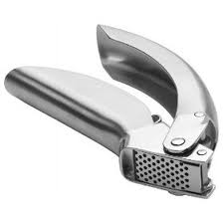
GARLIC PRESS
Function:
Crush garlic efficiently by forcing them through a grid of small holes
Might be using this – but may also be mincing garlic using a knife
Methods are said to have a different flavour

Slide 38
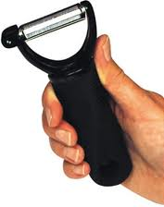
PEELER
Function:
Removes the outer skin or peel of some vegetables and fruits
Come in many different shapes
Easier to use than a knife to peel but you could still cut yourself

Slide 39
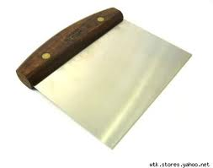
BENCH SCRAPER
Function:
Also known as a “dough scraper”
Used to move dough around and clean surfaces on which dough has been worked
Used to help pick up, turn and portion dough
Might use to remove dough from counter after rolling

Slide 40
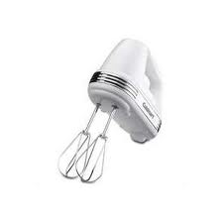
ELECTRIC MIXER
Function:
To mix, fold, beat and whip food ingredients
Electrically powered to make job easier and faster
Might used to make icings

Slide 41
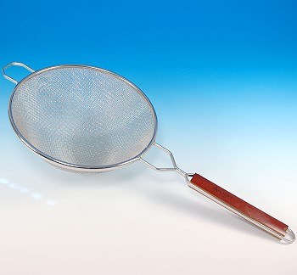
SIFTER
Function:
Put ingredients through this to add air and remove lumps
Used most commonly for flour and powdery dry ingredients
Will be using
Pay attention to wording “sifted flour” versus “flour sifted”

