Slide 1
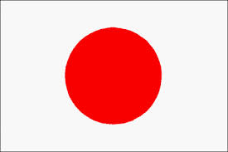
Japan

Slide 2
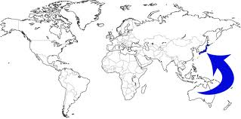
Location and Map

Slide 3
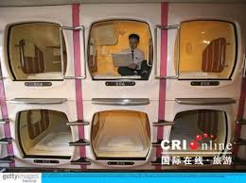
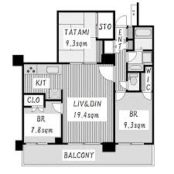
Population and Size
http://www.youtube.com/watch?v=J1TbiOI7RGs http://www.youtube.com/watch?v=F-M51iif6VE
Japan | Canada
Population: 128 million | 35 million
Size: 377,900km² | 9,980,000km²
Notes:
Almost 4x more people than canada but are 26x smaller than us

Slide 4
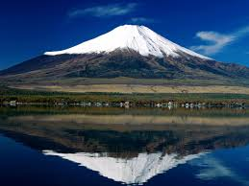
Famous for… Mount Fuji

Slide 5
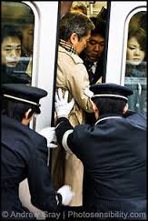
Famous for… Bullet Trains
Go really fast – up to 320km/hour
Are VERY FULL… People literally get stuffed in.
http://www.youtube.com/watch?v=E7kor5nHtZQ

Slide 6
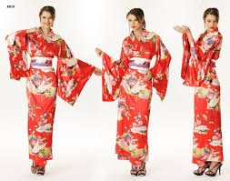
Famous for… Kimonos

Slide 7
Famous for… Sumo Wrestling
http://www.youtube.com/watch?v=UxhKb-zZoWE
http://www.intermartialarts.com/article/sumo-wrestler-diet

Slide 8
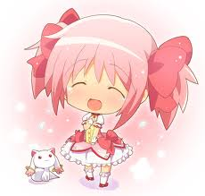
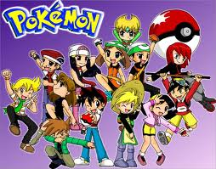
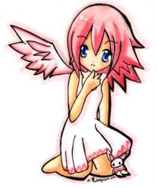
Famous for… Anime

Slide 9
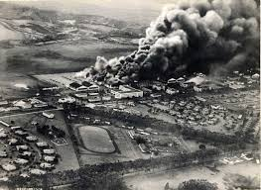
Famous for… Bombing of Pearl Harbour
http://www.youtube.com/watch?v=Sv1niwxQgoY
Notes:
December 1941

Slide 10
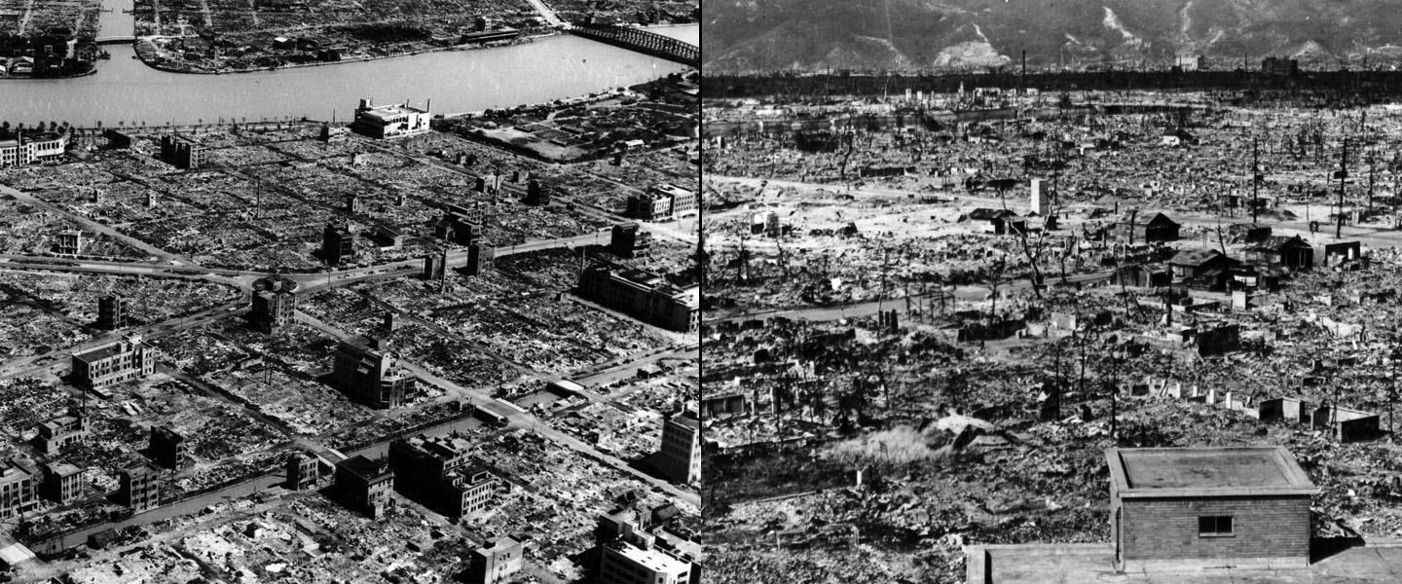
Famous for… Hiroshima
http://www.youtube.com/watch?v=t19kvUiHvAE
America’s retaliation from Pearl Harbour…
Dropped an atomic bomb on Hiroshima
Notes:
August 1945

Slide 11
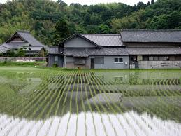
Famous for… Tea and Rice Fields

Slide 12
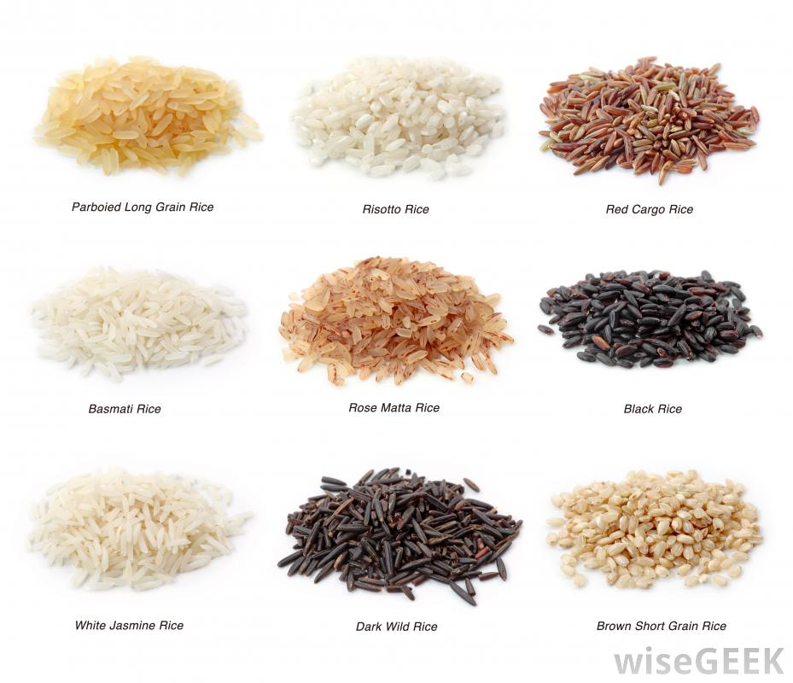
FOOD - Rice
Is a staple food in the Japanese diet
Often eaten with vegetables, in soups, in sushi, in rice balls and on its own
Is a grain similar to wheat
20% of the worlds calories are attributed to rice
Many different kinds of rice that vary in nutrients and cook time

Slide 13
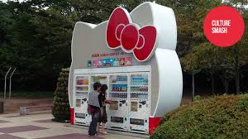
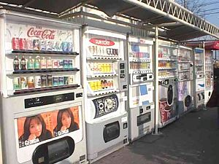
FOOD – Vending Machines
http://www.youtube.com/watch?v=ZZmUuRG87sU

Slide 14
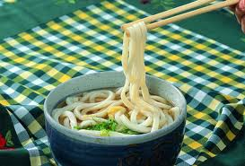
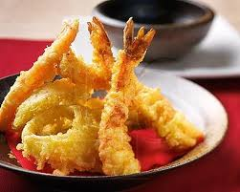
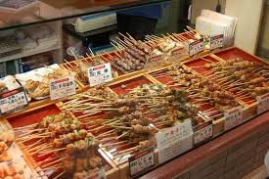
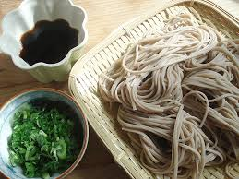
FOOD – Other Staple Foods
Eat a lot of RICE, FISH and VEGETABLES
Often use raw eggs, tofu and seaweed as well
Tempura – deep fried vegetables or shrimp
Yakitora – meat skewered and grilled
Soba (buckwheat) and Udon (wheat) – Japanese noodles typically served in a broth

Slide 15
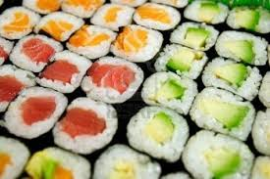
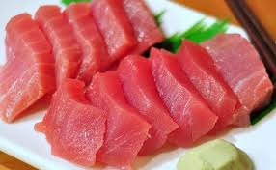
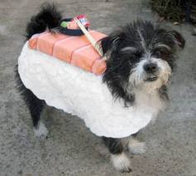
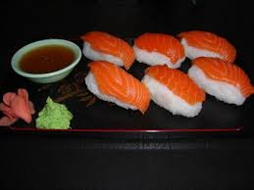
FOOD - Sushi
Made from short grain (Shari or Arborio) rice
1 cup rice = about 3 rolls
Rinse the rice, cook the rice and season with rice vinegar, sugar and salt
Need a bamboo mat to roll
Sushi – rice with veggies or raw fish with seaweed (nori)
Nigiri – rice with raw fish on top
Sashimi – raw fish
Basic Roll:
http://www.youtube.com/watch?v=swGJ2dIu9XE
Mosaic Roll:
http://www.youtube.com/watch?v=2X0-KeehZy4

Slide 16
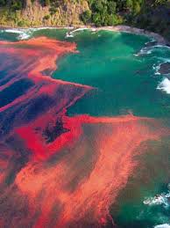
Sushi Safety
Raw Fish – must be frozen to -20 ºC for 7 days or -35 ºC for 15 hours to destroy parasites
Pregnancy – some fish contains mercury (tuna, swordfish, makerel, shark and tilefish) which could cause food borne illness which can be passed to the fetus causing developmental problems or even miscarriage
Salmon and tuna are considered low risk for mercury
Red Tide – algae high in toxins (saxitoxin) which effects fish and shellfish in that area
Paralytic Shellfish Poisoning

Slide 19
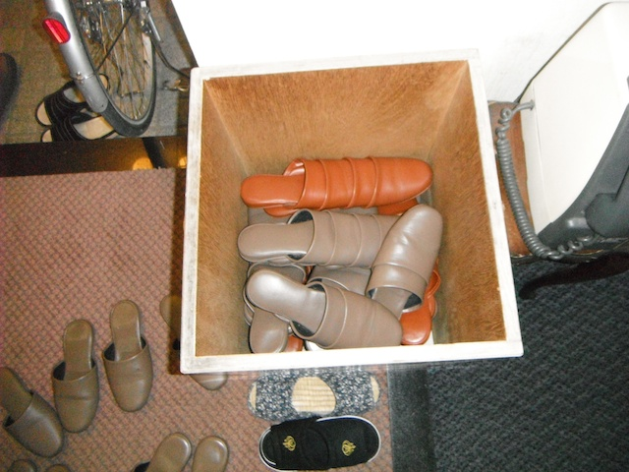
Eating Etiquette
Within Japanese houses and buildings you typically remove your shoes upon entering as Japanese houses are covered with tatami mats to sit and sleep on. Roads were muddy and wearing shoes inside would cause a mess and be rude
If a restaurant requires this they will often offer a storage cubby for your shoes and slippers while inside

Slide 20
Eating Etiquette
Sit on the floor with low tables to eat
This is traditional as well as it saves space in their small houses and floors were already covered in the tatami mats
In traditional settings must sit in seiza position (1)
In causal situations women (2) and men (3) have different positions they may sit in

Slide 21
Eating Etiquette
Start meals by saying “Itadaki-masu” meaning “I humbly recieve”
Use a small amount of sauce in a bowl not directly on food
Slurping is GOOD it shows you enjoy the meal
You must eat EVERYTHING on your plate – nothing goes to waste
Tipping is not common and considered rude in Japan

Slide 22
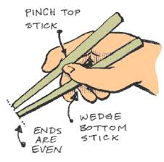
Using Chop Sticks (Hashi)
Don’ts…
Point at someone with chopsticks when talking
Wave chopsticks around over the food
Point chopsticks at food
Suck sauce off chopsticks
Rub chopsticks together
Stab food with chopsticks
https://www.youtube.com/watch?v=hSXwc9LwMuQ

