Slide 1
Hamburgers
Makes 1 Burger

Slide 2
Why are they called hamburgers?!
Originated in Hamburg, Germany
Many claims to where and how hamburgers came to be in North America
Why would they be considered a classic?

Slide 3
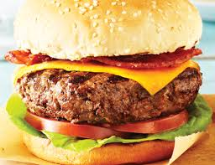
Ground Beef Burger
¼ pound ground beef
½ egg beaten
40ml dry bread crumbs
1 clove of garlic minced
5ml Worcestershire sauce
½ ml cayenne pepper
Salt and pepper to taste

Slide 4
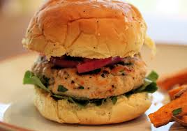
Turkey Burger with Spinach and Cranberries
¼ lb ground turkey
½ egg beaten
40ml dry bread crumbs
50ml spinach, chopped
25ml dried cranberries
Salt and pepper

Slide 5
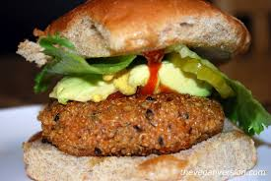
Quinoa Burger
50ml quinoa, cooked
30ml cheddar cheese
15ml egg, beaten
15ml cottage cheese
¼ of a carrot, shredded
7ml flour
¼ green onion
Dash of sugar
Dash of salt and pepper
Dash of cumin
Dash of garlic powder

Slide 6
???
Which burger do you think is the healthiest?
Which do you think takes the longest to cook?
Which do you predict will taste the best?

Slide 7
Making the Patty
Make sure ground beef is thawed
Put ground beef into a bowl
Add other ingredients
Mix with hands thoroughly
Form into a ball
Flatten balls slightly

Slide 8
Cooking the Burgers
Ideally – do this on a BBQ for about 5 minutes per side or until cooked all the way through
Us – heat frying pan on medium heat
Place burgers in pan – don’t grease the pan (need grease for quinoa – just a drop of canola oil)
Fry on each side for about 5-7 minutes per side
Test for doneness

Slide 9
The Burger
What do you want?! …
Buns
Ketchup
Mayo
Mustard
Lettuce
Tomato
Pickles
Onions
Mushrooms
Cheese
If you want bacon or anything else bring it from home!

Slide 10
Burger Questions?
What is the purpose of adding the egg to the burger patty?
Why is it a requirement in Canada that hamburgers be cooked “well done” not “rare” or “medium rare”?

Slide 11
McDonald Burger Basics
http://www.youtube.com/watch?v=wshlnRWnf30
http://www.youtube.com/watch?v=dCqKl4Q3hW4
What is pink slime?
How often do you eat McDonalds?
How does McDonalds or other fast food restaurant burgers compare to home made burgers?
Taste, cost, health, satisfaction, ease, keep you full?

Slide 12
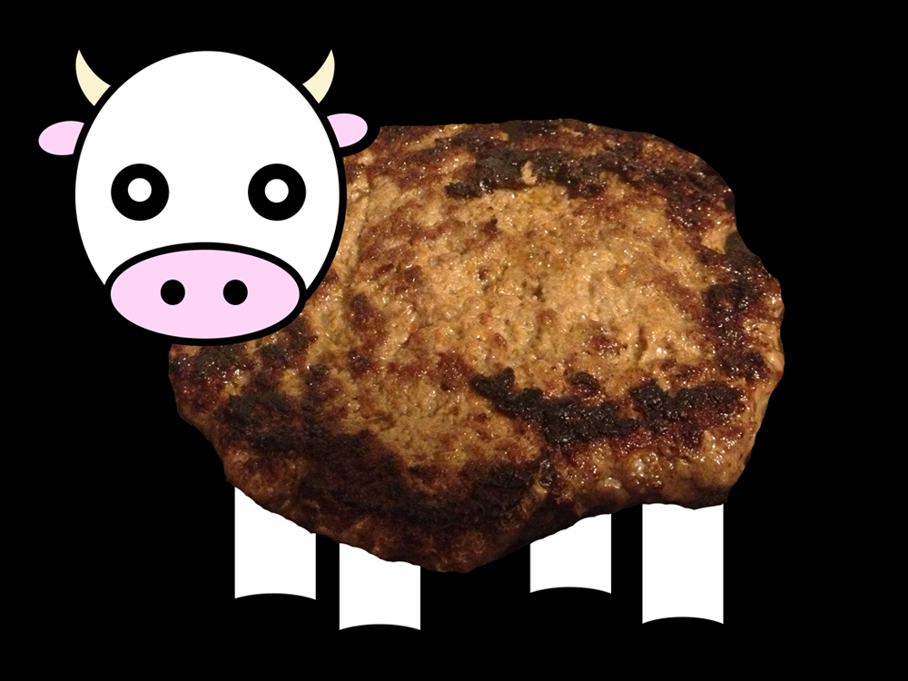
Our Burger Basics
The nicer the beef the less you have to add to making the beef patty.
Our beef is pretty decent… why are we still adding bread crumbs and seasoning?
Do you think low fat or full fat would make a better burger?

Slide 13
What is the most popular food in North America
BREAD!
So it makes sense that the choice of bun is very important
Some good buns for burgers…
Keiser (white or whole wheat)
Pretzel
Sesame
Poppy seed

Slide 14
Ready for an Episode of Diners, Drive ins and Dives

