Slide 1
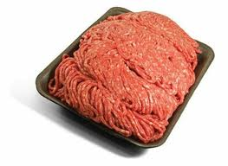
Ground Beef
(for meatballs!)

Slide 2
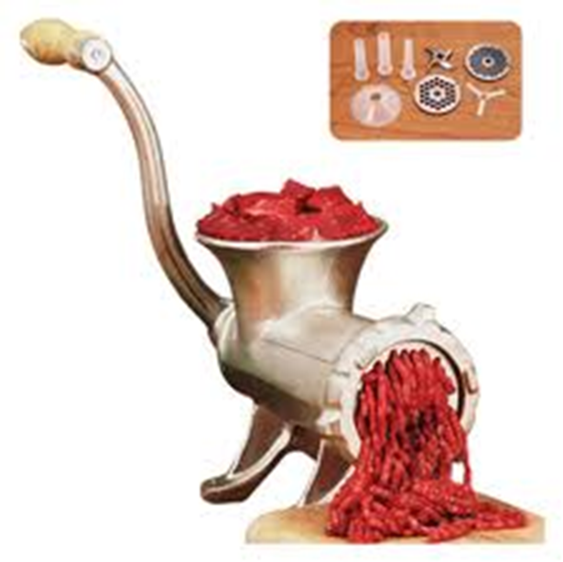
How it’s made…
Ground beef is made from the leaner, tougher, less desirable cuts of meat when a cow gets slaughtered
These cuts of meat are run through a grinder which is how it gets it’s texture

Slide 3
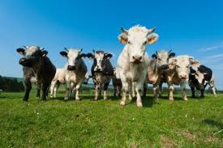
How many cows produce a single package of ground beef?!
Up to 1000 cows!!

Slide 5
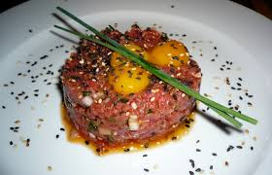
What ground beef is used in…
Notes:
Steak/beef tartar

Slide 6
Different types of ground beef?
Regular
Lean
Extra lean
Differences = amount of fat and the cost
regular = about 20% fat
lean = about 10% fat
extra lean = about 5% fat

Slide 7
Storage
There is an expiry date on the package – can be kept in the fridge if it is going to be used before that date
Can be kept in the freezer for 3-4 months
when ready to use can thaw 3 different ways:
fridge over night
microwave
warm running water

Slide 8
Cooking Safety
What do you need to be careful for when cooking?
make sure its cooked all the way through
be careful of oil spatter
cross contamination
Notes:
Cooking the beef properly – e coli
Cross contamination

Slide 9
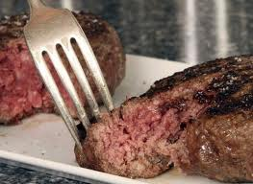
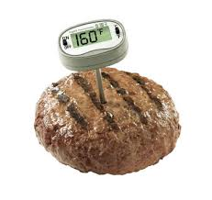
Cooking Safety
How do you know when ground beef is cooked all the way through?

Slide 10
E coli
Escherichia coli ← foodbone illness
Refers to a large group of bacteria that is commonly found in the intestines of humans and animals
Symptoms:
stomach cramps, diarrhea, vomiting and fever
Notes:
Recovery from illnes in 7-10 days

Slide 11
Why does ground beef have it?!
Ground beef is more likely to have e coli over other cuts of meat because…
Why is ecoli so prominent within cows?
in many farms cows are kept in close quarters, treated badly and forced to live in their own waste, making the spread of ecoli easier through feces from cow to cow
http://www.youtube.com/watch?v=s3L7lcMTELg

