Slide 1
GRAINS ON A PARADE

Slide 2
The three most widely used grains in the U.S are:
Wheat
Corn
rice

Slide 3
The seven types of cereal grain are:
Wheat
Corn Rice
Oats
Rye
Buckwheat
Barley

Slide 4
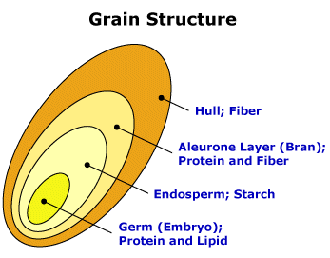
The most widely used cereal grain is:
Wheat
To the right an image of the cereal grain with its layers

Slide 5
The word cereal comes from the roman goddess:
Ceres – she was the goddess of agriculture, grain crops, fertility and motherly relationships. She was honoured in the May lustration of fields at the Ambarvalia festival, at harvest time and during Roman marriages and funeral rites.

Slide 6
Cereal grain
The brown outside covering the grain kernel that contains carbohydrates, minerals, protein and vitamins is: BRAN
The inner portion of the kernel is the: ENDOSPERM
The tiny living part of the kernel that contains proteins, vitamins, minerals, carbohydrates and fat is: GERM

Slide 7
When the product has original nutrients put back in it, it is called:
Restored
When the whole grain kernel is used the product is referred to as:
Whole grain
When extra nutrients have been added above the original amounts, a product is said to be:
enriched

Slide 8
The special protein found in wheat is called:
Gluten
Is the protein in cereal grains complete or incomplete?
Incomplete
The other name for Vitamin B1 in whole grain is:
Thiamine

Slide 9
The deficiency diseased caused by lack of Vitamin B1 is:
Beri beri
Vitamin B1 is needed by the body for:
Growth
Good appetite
Healthy nerves
Good body coordination
Helping body release energy from carbohydrates

Slide 10
`
The two major kinds of carbohydrates are:
Simple and complex
Three examples of simple carbohydrates are:
Sugar, brown sugar, honey, jams, jellies, candy
Three examples of complex carbohydrates are:
Bran, whole grain breads and cereals
Starch is used in the body for:
Body energy

