Slide 1
Frying

Slide 2
1. Keep water away from the hot oil
Water and oil don’t mix and spatter when put together
If the item you are frying needs to be washed or rinsed first make sure it is patted dry and put into the oil safely
http://www.youtube.com/watch?v=3x5OdiQEOq8

Slide 3
2. Wear an apron and oven mitts
Oil spatters ruin clothes and burn BADLY
But don’t move the pan or fryer if it is too heavy, too hot, or you don’t feel safe doing so
GRAPHIC VIDEO:
http://www.youtube.com/watch?v=-boMfnLnA6E

Slide 4
3. Know how to check oil temperature
Typically when frying you want it to bubble gently up over the food item
Too many bubbles means that the outside is going to cook too quickly possibly leaving a raw inside
Not enough bubbles could mean that the item is just sitting soaking up oil for a long time

Slide 5
4. Know how to clean up afterward
Oil should not be poured down the drain. Once cooled it can be poured into a container and used again or discarded.
Wipe out the fryer or pan once cooled with a towel before washing

Slide 6
5. Go slow!
Frying is a dangerous thing it is important to take your time
Speed causes spills and accidents
Also, all the spatter can get onto the floor causing slippery shoes as well
http://www.youtube.com/watch?v=8jjHXu4XrzU

Slide 7
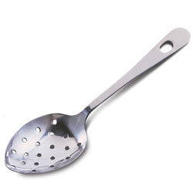
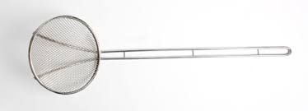
6. Use correct cooking utensils
Hot, hot oil melts plastic – make sure you are using metal or wood – but don’t leave metal siting in the oil otherwise it will conduct heat
While tongs are an okay tool to use to get the food into the oil safely they could potentially drop the food and cause splashing
A slotted spoon is the best tool to get food items in and out of the hot oil as it can lower nicely and drain excess oil

Slide 8
7. Clean up afterwards
Afterwards the stove and floor around will probably be a mess
Make sure to wipe everything up with a soapy towel so that people don’t slip later

Slide 9
8. If there’s a fire…
FIRST – turn of the heat!
Again – water and oil don’t mix – never try to put out a grease fire with water
Don’t use flour either
http://www.youtube.com/watch?v=GKL6QMVaT48
http://www.youtube.com/watch?v=Z366WmYXyGE
Use baking soda or salt or a tight fitting lid or heavy baking sheet to smother the flames
Fire extinguishers are ok – but could knock the pan over
http://www.youtube.com/watch?v=E0RgdYkc_Po

Slide 10
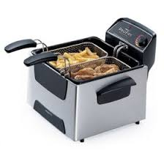
Deep Fry
A cooking method where the food is submerged into hot fat
If performed properly it should not produce super greasy food ass the water within the food repels the oil and steams the food from the inside
Uses a lot of oil = a lot of waste
Can be done in a deep fryer (see above picture) or a pot or pan

Slide 11
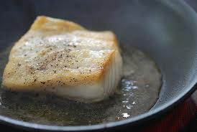
Pan Fry
Pan frying uses minimal oil or fat – opposed to shallow frying or deep frying
Shallow frying will be done in a pan – but not the entire thing will be submerged – instead you can flip the food over to get adequate browning all the way through

Slide 12
Bake
A cooking method that uses prolonged heat by convection, normally in an oven but also on hot coals
Does not require very much, if any, additional oil which keeps the food lighter and healthier
Often takes longer to complete the baking process

Slide 13
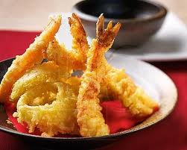
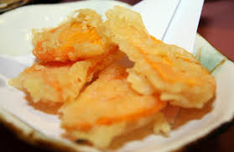
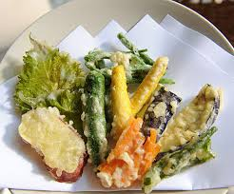
Tempura

Slide 14
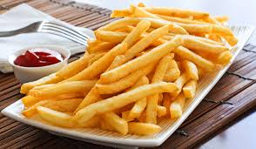
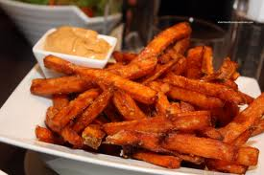
Fries

