Slide 1
Fruit Lecture

Slide 2
Botanical Names of Fruits
Pomes - Smooth skin and an enlarged fleshy area that surrounds the core.
Ex. apple, pear, kiwi
Drupes - Contain a single seed, or pit, surrounded by juicy flesh.
Ex. peach, cherry, plum, nectarines, apricot
Berries - Fragile cell structure; pulpy and juicy; tiny seeds embedded in flesh.
Ex. blackberries, cranberries, strawberries, grapes

Slide 3
Botanical Names cont. . .
Melons - Hard out surface that is smooth or netted; juicy flesh.
Ex. cantaloupe, honeydew, watermelon, casaba, crenshaw, muskmelon
Citrus Fruits - Grow in warm regions; firm rind and pulpy flesh.
Ex. oranges, grapefruit, tangerines, lemons, limes, kumquats, citrons, tangelos, and ugli fruit
Tropical Fruits - grow in very warm climates; differ in skin composition and seed characteristics. Ex. bananas, pineapple, avocados, dates, figs, mangos, pomegranates, and papayas

Slide 4
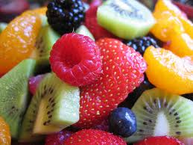
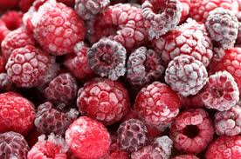
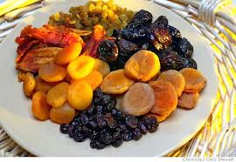
Form of Fruit
Fresh fruit
Canned fruit
Frozen fruit
Dried fruit

Slide 5
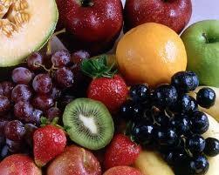
Guidelines for selecting Fruit
Buy fruits that are. . .
Firm to the touch
The right color
Well shaped
Heavy for their size
Aromatic
In good condition

Slide 6
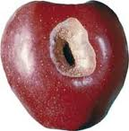
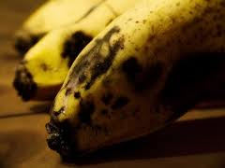
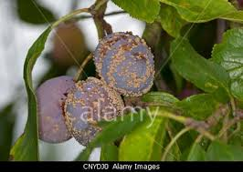
Avoid fruits that are. . .
Too soft
Too hard
Green or underripe
Damaged
Bruised
Decayed
Mildewed
Discolored

Slide 7
Storage of fruits
Fresh - ripe fruits are perishable and should be stored in special drawer to prevent rapid loss of moisture. They should be washed before storage, except for berries, which spoil quickly after being washed. Handle gently to avoid bruising. Ripen fruits (peaches, pears, plums, bananas) at room temperature and then store in refrigerator.
Frozen - store immediately in freezer. Do not thaw until ready to use. Do not refreeze after being thawed.

Slide 8
Storage of fruits
Canned - cool, dry place. After opening can, fruit becomes perishable and put in a plastic or glass container. Store covered in refrigerator.
Dried - cool, dry place in original container. After opening, close container tightly.

Slide 9
Nutrient contribution
Vitamins - vitamin C (ascorbic acid) - found in citrus fruits. Prevent scurvy
bones become fragile and break easily if body is lacking collagen, the cementlike material that holds cells together.
2. gums become soft and can bleed easily
3. walls of blood vessels and muscle cells become weak, less elastic, and frequently rupture, causing small pinpoint hemorrhages

Slide 10
Nutrient contribution cont. .
4. wounds and broken bones do not heal properly
vitamin A - found in fruits that are yellow to red in color contain carotene. Prevents night blindness. Yellow melons, pineapples, apricots, peaches
vitamin B - not as abundant as in other foods
Minerals - iron - for red blood , found in oranges, strawberries, cantaloupes; dried fruits - figs, dates, raisins, prunes, apricots

Slide 11
Nutrient contribution cont. .
calcium - for strong bones and teeth, found in oranges, strawberries, cantaloupes, dried fruits - figs, dates, raisins, prunes, apricots
Sugar and cellulose are carbohydrates found in fruits. They supply the body with energy. The skin and pulp contains cellulose which the body cannot digest which serves as a natural laxative to help maintain body regularity.
Fruits contain very little protein and fat.

Slide 12
Preparation of fruits
Most fruits are delicious and enjoyable when eaten raw. They are more palatable and have higher nutritive value.
Fruits can be cooked by:
simmering as in applesauce. (Fruits when cooked in moist heat, the cellulose becomes soft and the fruit breaks apart)
stewing as in peaches, or pears (Fruits cooked with sugar or in a sugar syrup will retain their shape and firm texture)
baking as in apples
microwaving

Slide 13
Preparation of fruits
Vitamin C can be destroyed by the exposure to oxygen in the air. Prepare just before serving.
Prepare in a small amount of liquid to preserve vitamins and minerals.
Cutting raw fruit with a low acid content, turn dark on exposure to air. This discoloration can be prevented by sprinkling the cut surface with an acid fruit juice - lemon juice, pineapple, orange, fruit fresh

Slide 14
