Slide 1
FoodSafe Level 1

Slide 2
Overview
FoodSafe is an 8 hour course that will help you work safely to prevent foodborne illness.
This package will not certify you, however you will be further ahead than others should you choose to take the actual FoodSafe course.
Why might you want this…. If you are working in the foodservice industry having your FoodSafe certification is recognized by many employers as a valuable and necessary employee qualification.
Notes:
In getting certified you will be required to take the 8 hour FoodSafe course, as well as write a mandatory final exam consisting of 55 multiple choice questions. You must obtain a 70% or higher to pass

Slide 3
Purpose
The purpose of FoodSafe is to:
Create awareness of foodborne illness and worker injury
Reduce the possibility of food related illness
Share the importance of safe work habits in the food industry

Slide 4
Objectives
The objectives of FoodSafe are to:
Emphasize food safety in a fast-paced, growth industry
Encourage prevention of foodborne illness
Protect the public and workers from harm
Apply safe procedures for receiving, storing, preparing and presenting food
Reduce common errors in handling potentially hazardous foods
Create awareness of the Top Workplace Safety Hazards and techniques for reducing risk of injury and illness

Slide 5
Topics Covered
Introduction to FoodSafe
Foodservice Illness and Injury
Receiving and Storing Food
Preparing Food
Serving Food
Cleaning

Slide 6
Topic 1: Introduction to FoodSafe

Slide 7
Major Topics
Top 10 Improper Food Handling Practices
Top Workplace Safety Hazards
Risks and Consequences
Responsibilities
Food Safety Plan

Slide 8
Learning Outcomes
By the end of Topic 1, you will be able to…
Describe the benefits of the FoodSafe program (o workers, employers and customers)
Identify the top 10 improper food handling practices causing foodborne illness
Identify the top workplace safety hazards and risks to workers
Explain why it is important for food handlers to learn and follow safe food handling procedures
Describe the responsibilities of all staff in ensuring food safety and worker safety
Recognize the importance of a food safety plan

Slide 10
Top Workplace Safety Hazards
Tools/equipment - knives, fryers or mixers
Hot materials/surfaces - oil, liquids, steam, grills and ovens
Slippery floors - water, grease or loose flooring
Manual handling - lifting, carrying or moving heavy equipment
Chemicals - bleach, oven cleaners and degreasers; biohazardous materials, handing sharp items and discarding waste
Other hazards (repetitive motion, violence, transportation, etc)

Slide 11
Notes:
Injuries from equipment, knives, etc – 27%
Burns and scalds – 21%
Slips and falls – 19%
Injuries from lifting, carrying, etc – 12%
Other hazards, repetitive motion, violence, transportation, etc – 12%
Chemical and biological hazards – 9%

Slide 12
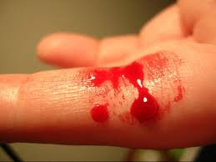
What are most common?
Cuts and bruises
Scalds and burns
Strains, sprains and fractures
Acute or chronic poisoning, illness and skin irritations

Slide 13
Risks and Consequences
You have an important role to minimize the risk of contamination when handling food.
Some consequences of improper handling include:
Workers become ill from handling contaminated food
Workers can suffer wage loss if outlet is closed
Employers can be forced to close a business if there’s an investigation
An employer’s reputation could be damaged
An employer is legally liable for damages awarded in civil lawsuits
Customers who eat contaminated food could become ill and in rare cases die

Slide 14
See. Think. Do.
If you aren’t sure if a task is safe, STOP and ask for help.
SEE IT
THINK IT
DO IT
Look at the task
Is there a risk of injury, disease or foodborne illness?
Take action to eliminate or control the risk

Slide 15
Responsibilities
Of workers…
Practice safe food handling procedures
Follow safe work procedures
Use the required personal protective equipment (PPE)
Report hazards, accidents and injuries to employer
Refrain from dangerous conduct
Ensure the ability to work is not impaired
Refuse to perform an assigned task when there is undue risk of injury or disease

Slide 16
Responsibilities
Of employers…
Develop a food safety plan
Provide a written cleaning and sanitation plan
Provide worker training and orientation
Provide supervision and regularly inspect the workplace
Provide first aid equipment and services
Provide adequate PPE
Establish a health and safety program
Establish safe work procedures

Slide 17
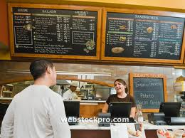
Responsibilities
Of customers…
Report food allergies to server
Ask the server about food ingredients that may pose a potential risk
Report foodborne illness incidents and injury to food handlers or supervisors

Slide 18
Food Safety Plan
A plan based on Hazard Analysis and Critical Control Points (HACCP)
Looks at all aspects, if there are any hazards at that step, what it is and its limits, how it can be prevented and the corrective action to be taken if met
Receiving
Storage
Preparation
Cooking
Hot holding
Cooling
Reheating

Slide 19
Topic 2: Foodservice Illness & Injury

Slide 20
Major Topics
Microbiology
Cycle of Transmission
Methods of Transmission
Causes of Foodborne Illness
Control Sources of Foodborne Contamination
2 Basic Types of Biological Foodborne Illness
Breaking the Links

Slide 21
Learning Outcomes
By the end of Topic 2, you will be able to…
Explain the difference between beneficial and disease causing microbes
Describe how harmful pathogens can cause illness in both customers and workers
Describe the conditions that promote bacterial growth
Describe the methods for controlling the transmission of pathogens
List the causes and sources of biological, chemical and physical foodborne illness

Slide 22
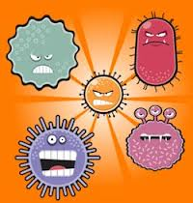
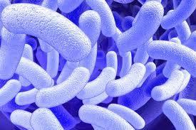
Microbiology
Microbes
Are living things that are often too small to be seen without the help of a microscope.
They are also known as micro-organisms.
Microbes that cause disease are called pathogens.

Slide 23
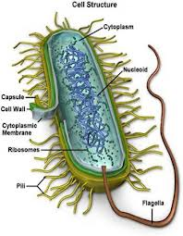
Microbiology
Bacteria
Are alive and all around us.
Most are harmless to humans but a few can be very dangerous.
The bacteria that live and grow in food may cause foodborne illness, and bacteria are one of the most frequent causes of foodborne illness

Slide 24
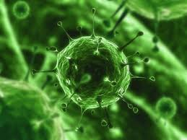
Microbiology
Viruses
Are smaller than bacteria and frequently cause illness.
Viruses harmful to humans may be found in food but will not grow in food.
Hepatitis A and Norwalk Virus are examples of viruses commonly transferred through food due to improper hand washing after toilet use.

Slide 25
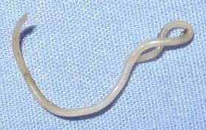
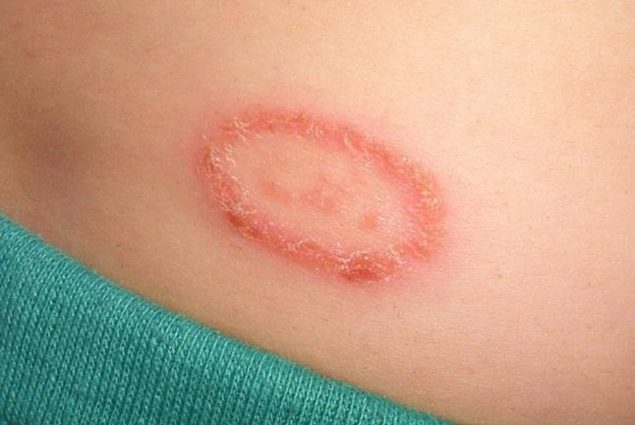
Microbiology
Parasites
Are organisms that live on or inside another animal or person, and are dependent on the host for nutrients.
Some parasites are large enough to see without a microscope (ex. Tapeworms)

Slide 26
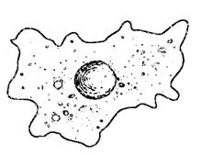
Microbiology
Protozoa
Are one-celled animals or microbes.

Slide 27
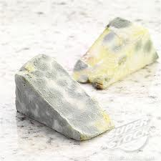
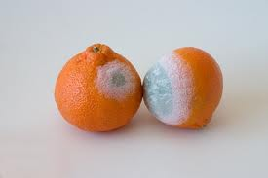
Microbiology
Fungi
Includes moulds and yeasts can be harmful.
Scraping of cutting off the mould may not make the food safe again.
The fungi may have produced toxins that will remain in the food.

Slide 28
Cycle of Transmission
There are 3 major parts to the cycle of transmission
FOOD
FOOD HANDLER ← most important link in the cycle
ENVIRONMENT

Slide 29
Cycle of Transmission
Food Handler
Skin
Nose
Hair
Hands
Clothing
Environment
Work surfaces
Utensils
Insects
Air
Food

Slide 30
Methods of Transmission
Direct Transmission → occurs when the microbes transfer directly from the source to the food
Such as touching, coughing or sneezing
Indirect Transmission → involves an intermediate step between the source of contamination and the receiver
Example cutting board or knife
Same as cross-contamination

Slide 31
Causes of Foodborne Illness
Biological
Bacteria
Viruses
Parasites
Protozoa
Fungi
Chemical
Cleaning agents
Pesticides
Dissolved metals
Physical
Glass
Toothpicks
Wood splinters
Hair
Bandages
Insect parts or droppings
Metal particles

Slide 32
Biological Causes
Biological causes of foodborne illness can be broken up into 2 other categories
Biological
Foodborne Intoxication
- Where the bacteria grows in the food and produces a toxin which makes you sick
Foodborne Infection
- Where the bacteria grows in the food then continues to grow in your gastrointestinal tract

Slide 33
Foodborne Intoxication
Symptoms = nausea, vomiting, fever, headache, diarrhea, stomach ache
Recovery = about 24 hours
Sources = people (cuts, boils, scrapes, burns, pimples, sneeze, cough)
Example = staphylococcus

Slide 34
Toxins
Generally toxins produced are…
Colourles
Odorless
Tasteless
Heat stable

Slide 35
Foodborne Infection
Symptoms = cramps, diarrhea, nausea, fever, vomiting
Recovery = 1-2 weeks
Sources = poultry and other animal sources
Example = salmonella

Slide 36
Chemical Causes
Incidents of chemical foodborne illness is not as common as those by pathogens
Improper storage of chemicals is often the cause
Properly label chemicals and store away from food prep and storage areas
Never use a food container to store chemicals
Acidic foods can dissolve tin, copper, zinc and lead

Slide 37
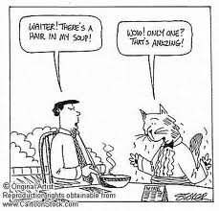
Physical Causes
Glass, wood, and toothpicks can cause injury if they enter the mouth or get swallowed
Hair, bandages and insect droppings can be health hazards – they are also aesthetically unappealing

Slide 38
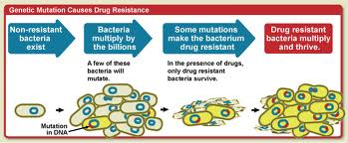
Causes of Foodborne Illness
Multiplying Bacteria
Bacteria grow by multiplying
When conditions are right bacteria can double every 20 minutes

Slide 39
0 = start time
20 minutes
40 minutes
1 hour
2 hours
8 hours
1 bacterium
2 bacteria
4 bacteria
8 bacteria
64 bacteria
33,554,432 bacteria
Safety margin

Slide 40
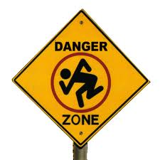
Danger Zone
What is that “right condition”…
Between the temperatures of 4-60 degrees celcius which is also called the DANGER ZONE!

Slide 41
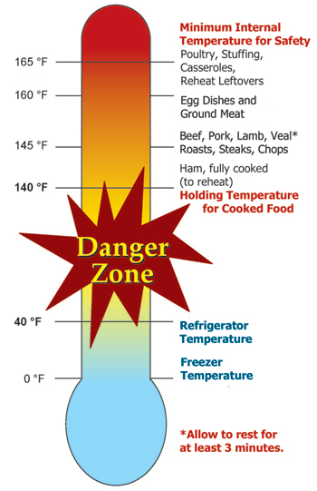

Slide 42
So what affects bacterial growth…
F → food (protein)
A → acid (pH scale)
T → time
T → temperature
O → oxygen
M → moisture

Slide 43
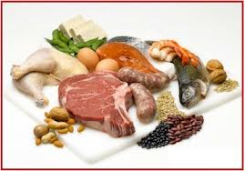
FATTOM continued
Food (protein)
Pathogens are most likely to grow in food that is a protein
Other foods like carbohydrates are less likely to contain pathogens

Slide 44
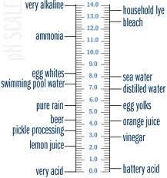
FATTOM continued
Acid (pH scale)
pH goes from 0 (acidic) to 14 (alkaline or basic)
A neutral pH will encourage pathogen growth
Disease causing bacteria do not grow well at a pH below 4.5

Slide 45
FATTOM continued
Time
As shown by our multiplication chart previously bacteria in optimal conditions can reproduce every 20 minutes, making 2 hours the safety margin for bacterial growth

Slide 46
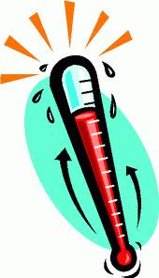
FATTOM continued
Temperature
Looking at the danger zone bacteria need optimal temperatures to reproduce
Bacteria multiple rapidly between 4-60 degrees in the danger zone
While most bacteria die at temperatures between 74-100 degrees
When cooling most bacteria survive at low temperatures but cannot grow

Slide 47
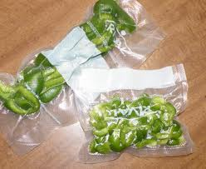
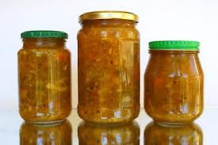
FATTOM continued
Oxygen
Some bacteria need oxygen to survive and grow, theses are called aerobic bacteria
Some bacteria can only grow when no oxygen is present and those are called anaerobic bacteria

Slide 48
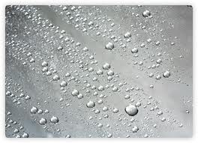
FATTOM continued
Moisture
When foods are dried they are less likely to allow bacterial growth, however once water is added they are in a more desirable environment to reproduce
Example: opening a sealed package of food – now have to store in fridge

Slide 49
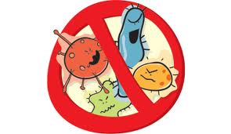
Control Sources of Food Contamination
WATER
MICROBES
HANDLING/USING UTENSILS AND EQUIPMENT

Slide 50
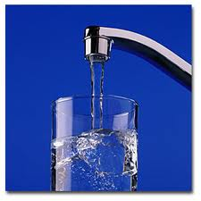
Water
Must be from a POTABLE source
Fit for human consumption

Slide 51
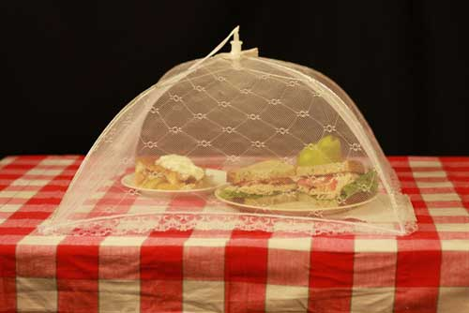
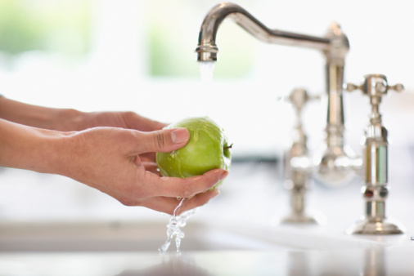
Microbes
Wash fruits and vegetables carefully in cold water
Protect food from insects and rodents
Pay attention to cross-contamination

Slide 52
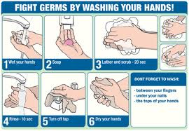
Utensils & Equipment
Wash hands regularly
Cover up scrapes and cuts with a band-aid and non-latex gloves
Reduce contamination by proper handling of utensils

Slide 53
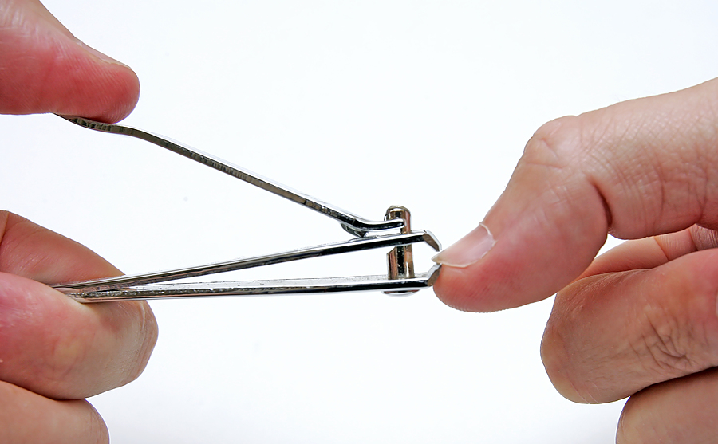
Breaking the Links
Pay attention to…
Hands and fingernails
Keep fingernails trimmed and clean underneath
When using gloves change them as often as you would wash your hands
If you touch or face or hair, wash your hands
Contaminated hands should be washed immediately

Slide 54
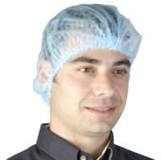
Breaking the Links…
Hair control
Hairnets reduce changes of hair falling into the food
Clothes and grooming
Uniforms or aprons may be contaminated so they should be changed daily or whenever necessary
Proper footwear is also important in preventing injury

Slide 55
Topic 3: Receiving & Storing Food

Slide 56
Major Topics
Receiving and Storing Procedures
Food and Chemical Storage
Manual Handling and Safe Storage

Slide 57
Learning Outcomes
By the end of Topic 3, you will be able to…
Identify the reasons for rejecting foods upon receiving
Practice safe procedures in receiving and storing of foods
Describe the storage of different classes of foods and chemicals
Describe safe manual handling and safe storing techniques

Slide 58
Receiving and Storing
Do not accept spoiled or damaged products
Use the First In, First Out (FIFO) principle
Note “best before” or “expiry” dates
Only accept food from an approved source
Do not overstock
Make sure an adequate amount of shelving is available at all times
Notify supervisor if stock is not used within a 6 month period

Slide 59
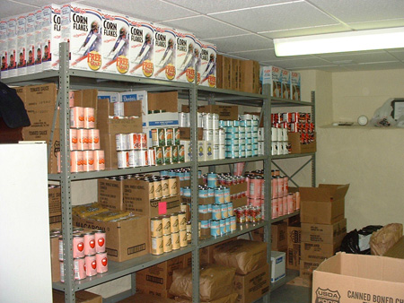
Food Storage
Group like foods together
Ensure airflow
Keep food off the floor
Store produce above meat
Don’t keep spoiled or out of date food

Slide 60
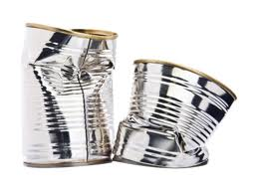
When in Doubt Throw it Out!
If you ever find a dented or bulging can or something that looks out of place follow this rule to ensure safety

Slide 61
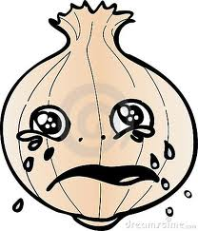
Effects of Moisture on Stored Food
Can provide conditions for cockroaches
Allows bacteria and mould to grow

Slide 62
Chemical Storage
Keep separate from food items
Store in a special chemical storage room or locked cupboard
Follow safe storage procedures
Do NOT store in improperly labelled containers
Must have a Material Safety Data Sheet (MSDS) for each Workplace Hazardous Materials Information System (WHMIS) product

Slide 63
Safe Lifting and Carrying Techniques
Use carts or dollies
Keep the load close to your body
Avoid stooped, twisted lifts
Face in direction of the lift
Bend knees and lift with legs, not back
Limit lifts to the range of knuckle and shoulder heigt
Use secure handles
Share heavy loads with a partner

Slide 64
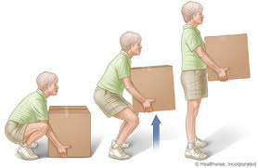
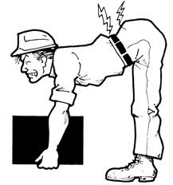
Lifting Techniques Bad! Good!

Slide 65
Topic 4: Preparing Food

Slide 66
Major Topics
Classification of Foods
Effects of Temperature
Effects of Time
Tools and Equipment
Hot Materials and Surfaces

Slide 67
Learning Outcomes
By the end of Topic 4, you will be able to…
List precautions when preparing potentially hazardous and less hazardous foods
Identify the effects of temperature and tie for cooking, hot holding, freezing, thawing, reheating and cooling food
Identify the potential sources of contamination through contact with water, microbes, utensils, and equipment during preparation
Apply methods for protecting food from contamination
Identify safety guidelines when using knives and operating equipment
Demonstrate appropriate techniques when working with hot materials and surfaces

Slide 68
Classification of Foods
Potentially Hazardous Foods
→ foods that satisfy all the requirements (FATTOM) for the growth of pathogens
→ examples: meat, poultry, fish, eggs, dairy products
→ handle these foods carefully and keep them out of the danger zone
Less Hazardous Foods
→ these foods can be dry, sweet, sour/acidic and/or salty
→ however, if you add FATTOM they could become a hazard
→ examples: bread, crackers, dry pasta, pickles, jam, hard boiled eggs

Slide 69
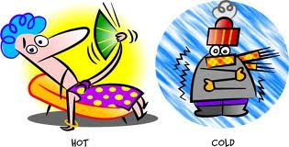
Effects of Temperature
Temperatures for cooking, hot holding, freezing, thawing/defrosting, reheating and cooling must be applied to ensure food safety

Slide 70
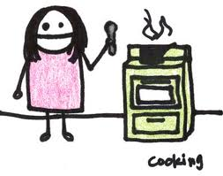
Cooking
Cook foods to the internal temperature of 74 degrees Celsius for a minimum of 15 seconds
If a food item is large, insert a thermometer into the thickest area
Cooked foods may not be safe because foods can get re-contaminated after cooking

Slide 71
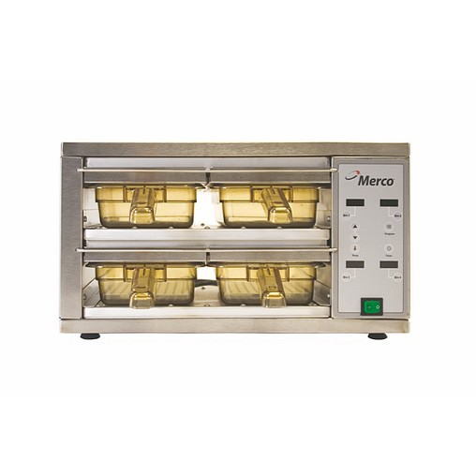
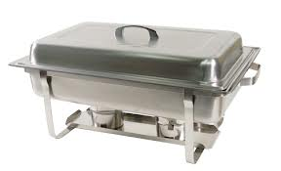
Hot Holding
Food in hot holding should be at least 60 degrees Celsius
Hot holding units – steam tables, warming ovens, heat lamps
Do not hot hold longer than 2 hours (safety margin)

Slide 72
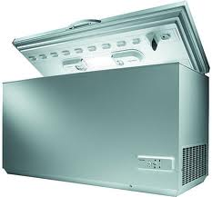
Freezing
Temperature must be below -18 degrees Celsius
The freezer in your house is unlikely to achieve this temperature
Freezing can kill viruses, parasites, protozoa and fungi. Bacteria survive but cannot grow and multiple at this temperature

Slide 73
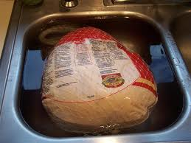
Thawing/Defrosting
Thaw in a refrigerator at less than 4 degrees Celsius not on the counter!
If you forget to thaw in the fridge and its dinner use the microwave
You can cook frozen if it’s a small quantity
Wrap foods in plastic wrap and thaw under cool running water
DO NOT THAW FOODS AT ROOM TEMPERATURE

Slide 74
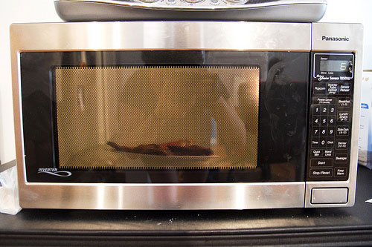
Reheating
Always reheat rapidly to a minimum of 74 degrees Celsius
Must reach that temperature within 2 hours
Never use warming ovens or steam tables to reheat
After reheating keep food above 60 degrees Celsius or serve right away
Only ever reheat ONCE

Slide 75
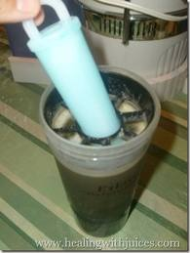
Cooling
Remove foods as quickly as possible once it enters the danger zone – put on ice or refrigerate
Use shallow metal pans and stir frequently to cool
Chill in small portions
Label every container with date and contents
Use ice wands or cooling wands

Slide 76
Cooling Continued…
Cool from 60 degrees to 21 degrees within 2 hours
Get from 21 degrees to 4 degrees or lower within the next 4 hours
= 6 hours total to get food cool!
If this cannot be achieved… THROW IT OUT!

Slide 77
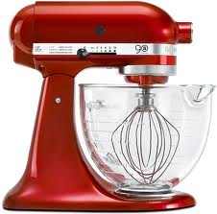
Tools & Equipment
Used on a daily basis when preparing food
Sharp tools, knives and equipment with moving parts may cause serious cuts, loss of fingers or other injury
Accidental start-up injury, electric shock or electrocution could occur when cleaning and maintaining equipment

Slide 78
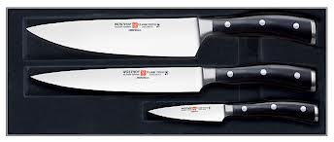
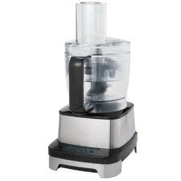
Avoiding Risk & Injury
How can workers avoid risk/injury when working with…
Knives
It should be sharp!
Use a flat, secure cutting board
Cut away from your body
Carry one knife at a time, tip pointed down, go slow!
Store knives securely
Food processors
Should have safety guards
Use pushers to avoid contact with blades
Do not put hands into operating machines

Slide 79
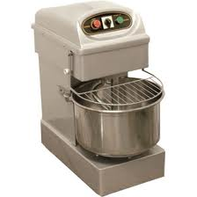
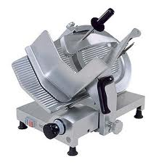
Avoiding Risk & Injury
How can workers avoid risk/injury when working with…
Dough mixers
Have interlocks and guards in place
Bowl must be locked in place
DON’T reach into machine while operating
Unplug or lockout before removing dough from mixer
Slicing machines
Have safety guards in position
Always use a feeding device
Meat thickness gauge should be set back to zero after using machine, then turn it off
Ensure machine is locked out or unplugged before cleaning

Slide 80
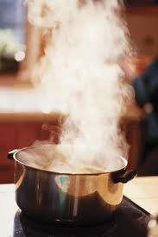
Hot Materials & Surfaces
Incidents of burns and scalds can be avoided if you…
Use dry oven mitts
Lift lids away from you
Wear long sleeve, fitted cotton shirts, long pants and closed toe shoes with non-slip soles
Use tongs or frying baskets to lower food into hot oil
Don’t put just washed food into oil
Turn hot water faucets on slowly to avoid splashes

Slide 81
Topic 5: Serving Food

Slide 82
Major Topics
Personal Habits and Hygiene
Setting Tables
Serving Food
Food Protection and Transportation
Food Allergies and Foodborne Illness Complaints
Transmitting Illness and Disease

Slide 83
Learning Outcomes
By the end of Topic 5, you will be able to…
Describe personal hygiene in a foodservice establishment
Demonstrate sanitary practices in the serving and dispensing of food
Use effective sanitary practices when setting and clearing tables
Describe techniques for safe carrying and serving
Identify techniques to prevent slips and trips
Explain why illness, infection and injury are situations when not to work
Describe the procedure for handling food allergies
Identify the process for handling a foodborne illness complaint

Slide 84
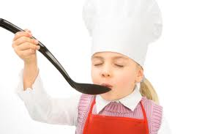
Chefs… TASTE FOOD OFTEN!
But… when tasting…
Use a disposable spoon or a regular spoon only once
Ladle the food into a cup then taste it

Slide 85
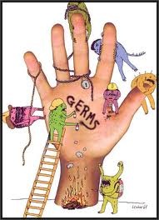
When Should You Wash Your Hands?
After…. Sneezing, coughing, using the toilet, handling raw food, cleaning, handling soiled items, smoking… OFTEN!
Why? … because during these tasks you pick up pathogens, then things you touch afterwards can be cross-contaminated

Slide 86
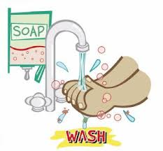
Washing Hands
Methods:
Use a designated hand washing sink
Use liquid soap – not bar soap
Use warm running water
Use a nail brush
Use a single service towel or air dryer
Wash for at least 20-30 seconds
Use the rotary method for friction to remove germs – front, back, wrist, between fingers

Slide 87
Gross Statistic…
A study showed that 91% of people claim to wash their hands after washroom use
However… 17% of people do not wash
Fewer people wash hands after handling money (21%), petting animals (42%), or after coughing/sneezing (32%)

Slide 88
Setting Tables
Place inverted glasses on placements and inverted cups on saucers – protect the business end
Keep hands away from food when handling dishes
Handle every glass by its base
Don’t pick up cutlery by the business end
If leaving table set – wrap the cutlery to avoid contamination

Slide 89
Serving Food
Use tongs to serve food – tong handles shouldn’t be in contact with food
Use proper scoops for ice
Store ice cream scoops with cold running water, or wash after each use
Avoid touching surfaces that may touch a persons food or mouth
Discard leftovers

Slide 90
Single Service Items
These are items which are to be used once then thrown away
Items include:
Straws
Paper cups
Plastic cutlery

Slide 91
Self-Service Process
What’s that called? A sneeze guard!!
Self serve present many risks for food contamination
If not properly displayed food can enter the danger zone!
Food placed in display units should be heated or cooled to the correct temperatures
When refilling, new food should NOT be placed on top of old food

Slide 92
Food Protection & Transportation
Carrying and serving tips…
Use a tray to avoid placing plates on the arm to reduce risk of contamination
Balance items evenly on tray with heavier items in the center
Rest muscles for 5-10 seconds after carrying heavy items
Its better to make more trips with smaller loads
Preventing slips and trips
Wear good shoes, closed toe, with non-slip soles
Clean spills immediately and clean floors regularly
Use slip resistant floor waxes
Keep passageways clear of clutter
Walk – do not run
Inspect carpeting/mats for tripping hazards

Slide 93
Food Allergies
Many people suffer adverse reactions to specific food ingredients or to chemical substances added to the food
Make sure you…
Know the ingredients in each food item
Some people will allergies can be so sensitive that even trace amounts could cause a fatal reaction
Avoid latex gloves because latex is a common allergy, and a customer could react to a food that has been touched by latex
Do not use the same utensils for known allergens on other foods due to cross contamination

Slide 94
Foodborne Illness Complaint
If someone complains of a foodborne illness… you should refer them to the manager!
If the manager is not available…
Take down particulars – name, address, phone number, number of people in party and time of day
Contact the manager who will report the complaint to the Public Health Inspector
Do NOT give medical advice

Slide 95
Transmitting Illness & Disease
In many cases illness means that the number of pathogens have grown in a large number that they overwhelm the bodies natural defences
The food handler must not work when ill

Slide 96
Food handlers & customers carrying disease organisms
From respiratory tract through coughing & sneezing
From open sores, cuts and boils
From intestinal tract through hands soiled with feces
Food prepared & served
Food eaten
Illness occurs

Slide 97
Topic 6: Cleaning

Slide 98
Major Topics
Clearing and Cleaning
Procedures for Proper Ware Washing
Types of Dishwashing
Other Cleaning

Slide 99
Learning Outcomes
By the end of Topic 6, you will be able to…
Apply effective sanitary procedures when clearing and cleaning tables
List correct temperatures and describe safe procedures for manual and mechanical ware washing
Describe correct test methods and concentrations for chemical sanitizers and disinfectants
Describe correct storage procedures for sanitized ware
Recognize chemical hazards and follow proper safe handling procedures
Safely sanitize “clean-in-place” equipment
Identify safety practices to reduce risk of injury from biohzardous materials
Describe the precautions to be taken when discarding waste materials

Slide 100
Procedures for Proper Ware Washing
1. Organization
2. Scraping and Pre-Soaking
3. Sorting and Racking
4. Washing
5. Rinsing
6. Sanitizing
7. Air Drying
Help but are not essential
Key steps

Slide 101
Continued…
Organization
Check for appropriate cleaning supplies
Ensure hot water is available
Scraping and Pre-Soaking
Use hot water and good friction (nylon brushes/pads)
Soak flatware and utensils for 10-15 minutes
Pre-soak dirty pots, pans and cutlery

Slide 102
Continued…
Sorting and Racking
Items the same size/shape should be washed together
Place utensils “business end” up
Washing
Use a good detergent
Change water frequently

Slide 103
Continued…
Rinsing
Rinse to remove detergent
Sanitizing
Can be completed using hot water or chemical sanitizers
Completed at a minimum of 82 degrees
Air Drying
Never towel dry or polish = re-contaminating
Drain boards should be clean and made of sanitized stainless steel or plastic
Ware should be dry and cool before storage

Slide 104
Sanitizing
Hot water is the most effective and cheapest form
Chemical Sanitizers…
Chlorine bleach (leaves a residue)
Iodine
Quats (Quaternary Ammonium Compounds)

Slide 105
Storing Sanitized Ware
Store off of the floor, away from dust, garbage, food or splashes
Clean and sanitize dish racks and shelving regularly
Handle ware with clean hands
Remove unclean dish ware and rewash

Slide 106
Types of Dishwashing
There are 2 different kinds
Manual
Mechanical - dishwashing or glass washing

Slide 107
Manual
Requires 3 different types of sinks
1. Washing – in clean water
2. Rinsing – in clean, hot water
3. Sanitizing – for 2 minutes in chemical solution or hot water

Slide 109
Mechanical
Mechanical - dishwashing or glass washing
This uses jets of hot water at a minimum of 60 degrees and chemicals to loosen and remove soil
After rinsing sanitizing is done at 82 degrees for 10 seconds
Dishwasher maintenance is crucial
Glass washers operate at lower temperatures and use chemical sanitizers

Slide 110
Cleaning Electrical Equipment
For plugged in…
Lockout = turn off equipment and pull plug, keep plug without your sight and apply a lockout cap to it
For permanently connected equipment…
Turn off and disconnect from power source
Apply a lock to the breaker

Slide 111
Cleaning Large Areas
Aka: flours, walls and surfaces
Make sure to…
Clean on a regular basis
Clean spills right away
Use salt on spilled grease or oil that cant be cleaned immediately
Place non-slip mats in appropriate areas

Slide 112
Biohazardous Materials
Cuts or nosebleeds can cause spills of blood that require clean up. Human blood and body fluids can contain bloodborne pathogens that can cause serious disease like Hepatitis B, C and HIV.
Treat all body fluids as potentially infectious.

Slide 113
Precautions During Clean Up
Wear puncture and liquid resistant gloves
Use disposable towels
Disinfect area with one part bleach to ten parts water and leave solution on for 10 minutes
Broken glass or ware should be separated for safe disposal (broken glass container)

Slide 114
Discarding or Collecting Garbage
Wear puncture resistant and liquid resistant gloves
Use tools to pick up spilled garbage, not your hands
Use waterproof garbage bags
Don’t reach into areas if you cant see its contents
Be alert to sharp items sticking out of the bag
Don’t let garbage bags get too full
Carry the bag from the top
Hold bag away from your body
Don’t place a hand under the bag to support it
Don’t compress garbage

