Slide 1
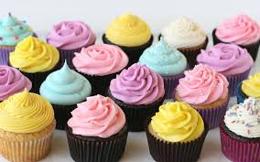
Cupcakes

Slide 2
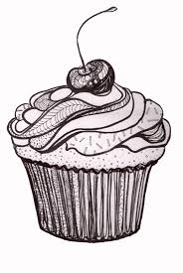
History of the Cupcake
Cupcake –
baking used to be measured by weighing ingredients
cupcakes changed this because they started using cups for measurement
1 cup of butter, 2 cups of sugar, 3 cups of flour, 4 eggs… = 1, 2, 3, 4 method

Slide 3
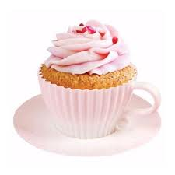
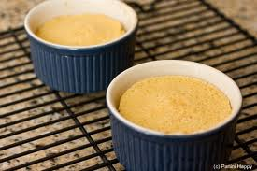
History Continued…
First recipe of a “cupcake” dated back to 1828 which gives instructions for a cup measured cake
In the olden days ovens couldn’t handle making full sized cakes without burning so they were made in tea cups or ramekins

Slide 5
Why Make Em?
Cupcakes were convenient because they took less time to bake than large cakes
They are portion controlled (as long as you eat just one)

Slide 6
Cupcake versus Muffins
Cupcakes:
Traditionally sweet
Usually frosted
Have a lighter consistency
Uses the cake/cookie method of creaming butter with sugar and mixing ingredients until smooth
Muffins:
Traditionally savoury
Not frosted
Denser consistency
Uses the muffin method of a lumpy batter not thoroughly mixed

Slide 7
Method:
Proper measurement of ingredients is CRUCIAL to perfectly baked cupcakes
Start by creaming butter and sugar
Add other wet ingredients
Mix dry ingredients together in separate bowl then add to wet mixture
Pour into liners ¾ full
Check by inserting a toothpick

Slide 8
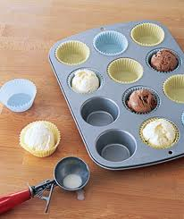
Tips and Tricks
http://www.youtube.com/watch?v=v3G-U7Nwvsg
http://www.youtube.com/ watch?v=8_-kCEo7P2g

Slide 9
Baking:

Slide 10
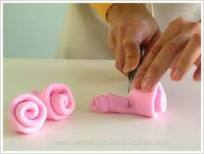
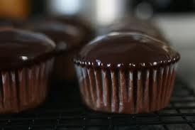
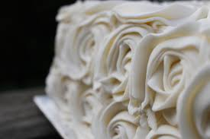
Icing Cupcakes:
Frosting versus Icing
Different types of icing…
Rolled fondant
Whipped cream frosting
Ganache
Sugary frosting
Chocolate glaze
Gumpaste
Chocolate frosting
Meringue buttercream
Royal icing
Notes:
Rolled fondant – like playdough, made of icing sugar, corn syrup, oil and flavorings, rolls out like pie dough over cakes and dries smooth. Can be used for covering cakes or making decorations
Whipped cream frosting – made from whippign cream, sugar and vanilla. Its light and airy, best for berry desserts
Ganache – whisking solid chocolate into heavy cream. Can be used as a glaze if really hot and not thickened, or a filling or a spread – can be rolled into balls to make truffles
Sugary frosting – american buttercream with icing sugar, butter, vanilla and milk – it holds its shape when piped
Chocolate glaze – from melting chocolate and butte together, cannot pipe. Used to pour over cupcakes
Gumpaste – similar to fondant. Dries rock hard and no taste at all. Best for decorations
Chocolate frosting – same as sugary frosting with cocoa or chocolate for flavour
Meringue buttercream – granulated sugar, egg whites, butter, vanilla and salt. Good for frosting because it holds it shape and is very versatile
Royal icing – very glossy and sweet, pipes beautifully and dries hard – good for things like gingerbread houses

Slide 11
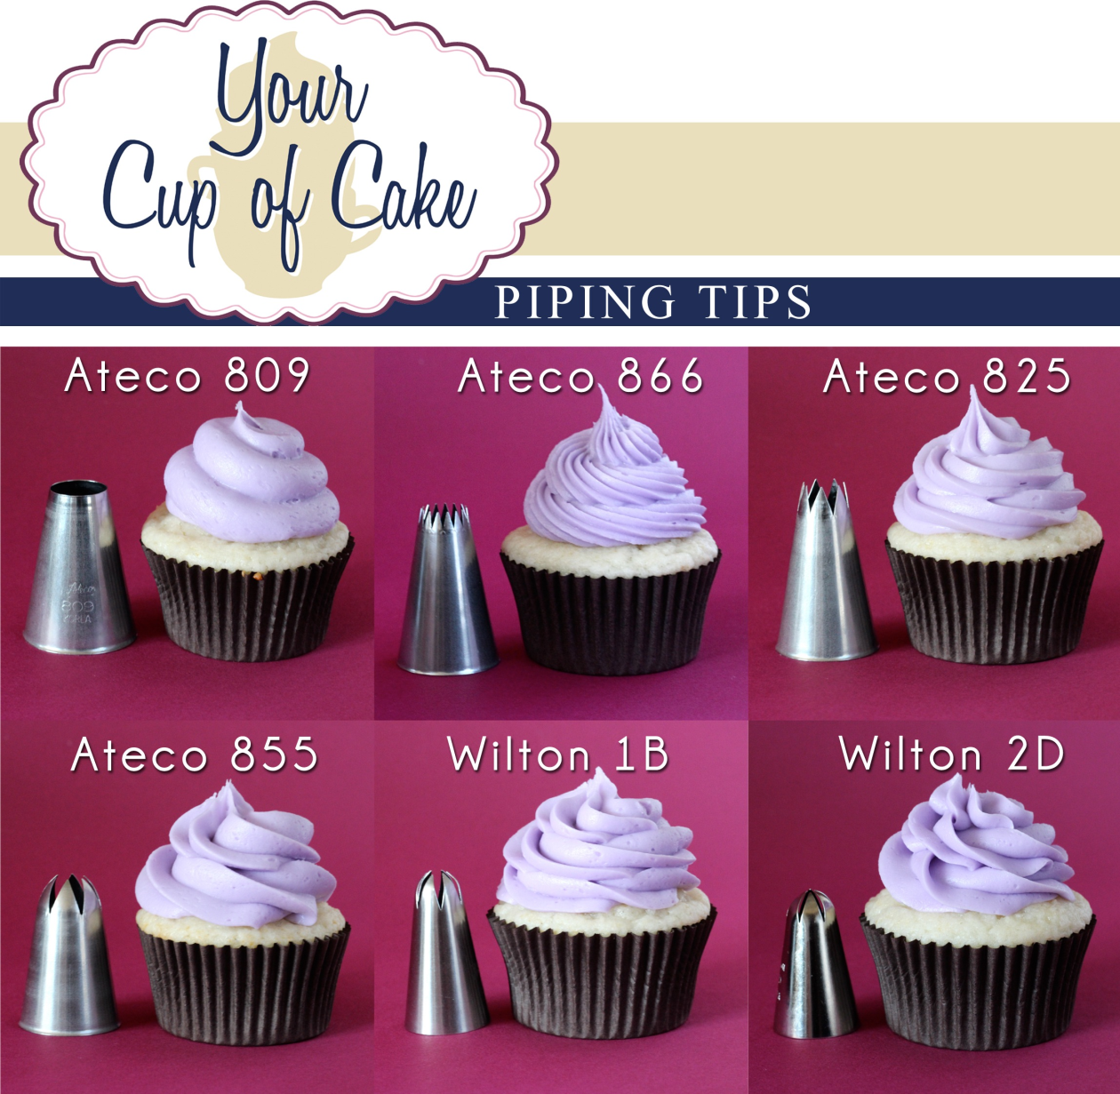
Decorating Cupcakes:
http://www.you tube.com/watch ?v=RZhEw4vHf uA
Piping:
Different tips make different designs
Basics…

Slide 12
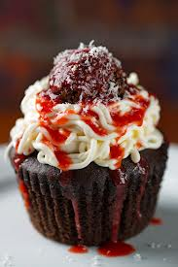
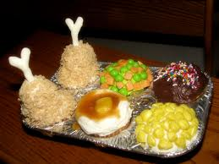
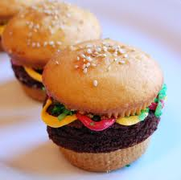
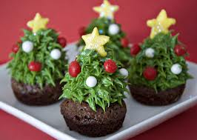
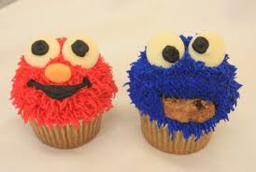
Decorating Cupcakes
Then people went nuts and got creative…

Slide 13
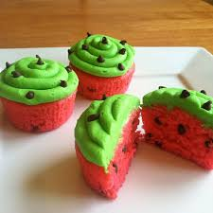
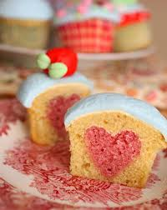
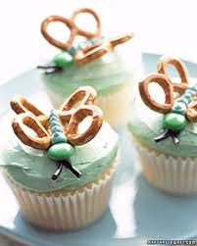
Cupcake Wars
Groups of 2-3
Must…
Find a cupcake recipe to make the actual cake, frosting and decoration
Creatively decorate the cupcake
Creatively display the cupcake

Slide 14
Cupcake Wars Continued…
Will be given class time to find a cupcake recipe and how you wish to decorate
Will be able to prepare some decorations and display in advance
Must bake the cupcakes and decorate on the day of cupcake wars

Slide 15
Cupcake Wars Continued…
Two best cupcakes per group will be submitted to cupcake wars to be judged by a panel of teachers from the school
Will be ranked based on appearance and taste
Together these will be put together to find the winner of cupcake wars

Slide 16
Rubric
 | Two Thumbs Way Up – could sell this in a bakery | One Thumb Up – could share with friends and family | Thumbs Down – eat it alone so no one sees it
Work Habits | Group times activities well to complete cupcakes and clean-up in class time without reminders. Group members are all on task during cupcakes wars. Work divided evenly among group members. | Group times activities okay to finish in class with few reminders. Group members are usually on task. Work divided mostly evenly among members with someone taking more of a lead role. | Group has poor time management and needs lots of reminders. Group members are off task multiple times. Group does not divide tasks evenly with one person doing the majority of the work.

Slide 17
Rubric Continud
 | Two Thumbs Way Up – could sell this in a bakery | One Thumb Up – could share with friends and family | Thumbs Down – eat it alone so no one sees it
Appearance | Decoration: fully decorated, can identify what it is meant to be Frosting: appealing colour, used appropriate frosting technique Cupcake: golden around edges, cooked through | Decoration: not fully decorated, cannot identify what it is meant to be Frosting: colour does not add to the appearance of the cupcake. Okay attempt at frosting technique Cupcake: too dark or light. Overcooked or undercooked slightly. | Decoration: not decorated or cannot tell what it is meant to be Frosting: unappealing colour/look. Done poorly. Cupcake: burnt or not cooked through. Has not risen.

Slide 18
Rubric Continued…
 | Two Thumbs Way Up – could sell this in a bakery | One Thumb Up – could share with friends and family | Thumbs Down – eat it alone so no one sees it
Taste | Decoration: is edible. Adds to the overall taste of the cupcake. Frosting: tastes good, is not too much or too little. Smooth texture. Cupcake: good flavour, not burnt or doughy. | Decoration: is partly edible. Is okay but doesn’t add to the overall taste. Frosting: tastes okay has a bit too much or too little. Texture isn’t quite smooth. Cupcake: okay flavour, kind of burnt or doughy. Some ingredients are slightly too much or not enough. | Decoration: is not edible. Difficult to eat or tastes bad. Frosting: tastes bad, has way too much or too little. Texture is gritty. Cupcake: tastes bad. Is burnt or doughy or added too much/not enough of an ingredient.

Slide 19
Cupcake Wars:
If time… watch another episode of cupcake wars for inspiration!!

