Slide 1
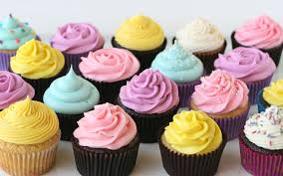
Icing, frosting, toppings, etc

Slide 2
Icing Cupcakes:
Frosting versus Icing is there a difference?
The names are quite often used interchangeably
Frosting is supposed to be thick for coating the outside, fluffy, with a cream or butter base and buttery taste
Icing is supposed to be glossy with a sugar or egg white base, it is thin with a sugary flavour
Both can be used to decorate baked goods

Slide 3
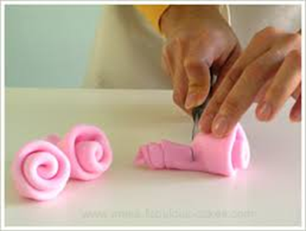
Rolled Fondant
Is similar to play dough
Made of icing sugar, corn syrup, oil and flavourings
Rolls out like pie dough over cakes and dries smooth
Can be used for covering cakes or making decorations

Slide 4
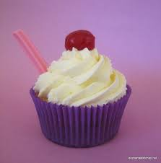
Whipped Cream
Made from whipping cream, sugar and vanilla
Its light and airy, best for berry desserts

Slide 5
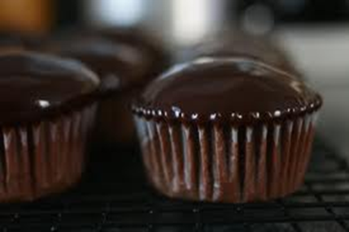
Ganache
Made by whisking solid chocolate into heavy cream
Can be used as a glaze if really hot and not thickened, or a filling or a spread once cooled and thickened
It can also be rolled into balls to make truffles

Slide 6
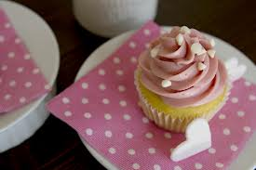
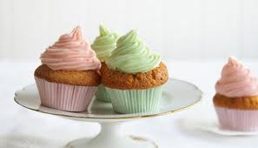
Sugary Frosting
Also called BUTTERCREAM
Made with icing sugar, butter, vanilla and milk – it holds its shape when piped and makes an excellent cupcake topper

Slide 7
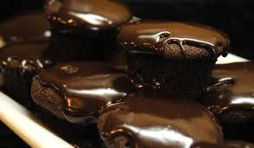
Chocolate Glaze
Made from melting chocolate and butter together
However, you cannot pipe this topping is instead used to pour over cupcakes or dip the tops into

Slide 8
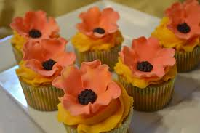
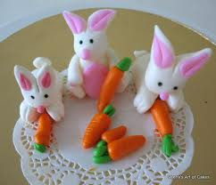
Gumpaste
Similar to fondant
Dries rock hard and no taste at all
Best for decorations – but not ones you can eat later! Will save FOREVER!

Slide 9
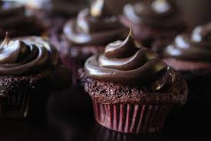
Chocolate Frosting
Same as sugary frosting with cocoa or chocolate added for flavour and colour

Slide 10
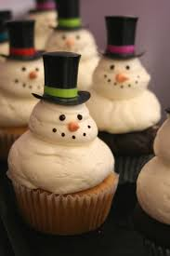
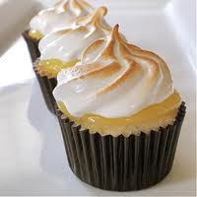
Meringue
Made out of granulated sugar, egg whites, butter, vanilla and salt
Good for frosting because it holds it shape and is very versatile

Slide 11
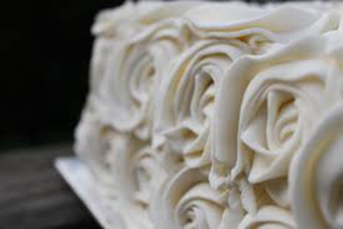
Royal Icing
very glossy and sweet
pipes beautifully and dries hard
good for things like gingerbread houses
Made out of whipped egg whites, icing sugar and lemon juice

