Slide 1
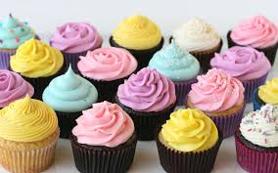
History of the Cupcake

Slide 2
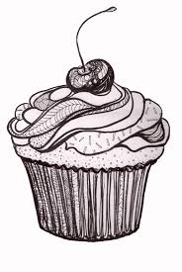
Once upon a time..
baking used to be completed by weighing ingredients, not by measuring
cupcakes changed this because they started using cups for measurement!
Here is a standard recipe:
1 cup of butter, 2 cups of sugar, 3 cups of flour, 4 eggs… = 1, 2, 3, 4 method

Slide 3
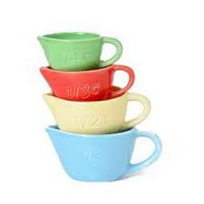
Why is it called a cupcake anyways?!
First recipe of a “cupcake” dated back to 1828 which gives instructions for a cup measured cake (the 1, 2, 3, 4 method)

Slide 4
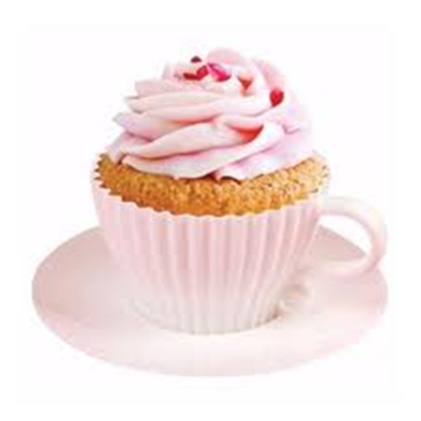
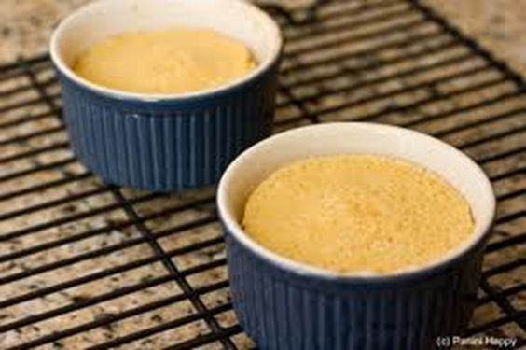
Why’s it called a cupcake anyways?!
In the olden days ovens couldn’t handle making full sized cakes without burning them, so instead they were made in tea cups or ramekins

Slide 6
Why Make Em?
Cupcakes were convenient because they took less time to bake than large cakes
They are portion controlled (as long as you eat just one)

Slide 7
Method:
Proper measurement of ingredients is CRUCIAL to perfectly baked cupcakes
Start by creaming butter and sugar
Add other wet ingredients
Mix dry ingredients together in separate bowl then add to wet mixture
Pour into liners ¾ full
Check by inserting a toothpick

Slide 8
Baking:

Slide 9
Red Velvet
Called so because it has a smooth velvety texture and red colour
In the olden days…
The red colour for the red velvet came from the chemical reaction from the acidic vinegar and buttermilk and cocoa powder
Other ingredients such as boiled beats were also added to increase the red colour

Slide 10
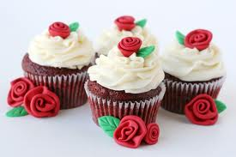
Red Velvet
In the not so olden days..
We use red food colouring to give the red flavour, but a lot is needed give a very red colour

Slide 11
Anthocyanin's
These are the chemical pigments that give off the colours blue, red and purple
Foods high in anthocyanins are powerful antioxidants and help prevent cancer

Slide 12
Video on Cupcakes versus Muffins
http://www.youtube.com/watch?v=wMfUPNnVcw4

