Slide 1
Chicken Wings

Slide 3
Buffalo Wings
Why Buffalo Wings?!
(start time: 1:55) http://www.youtube.com/watch?v=E9C6eP_oDAw
It was created in Buffalo, New York in 1964
Typically refers to hot wings
http://www.youtube.com/watch?v=OBdT66Krndc

Slide 4
So Many Flavours…
Buffalo Wings with Blue Cheese Sauce
Honey Garlic Wings
Salt and Pepper Wings
Sweet and Spicy Wings
Teriyaki Wings
Sweet Chilli Thai Wings
BBQ Wings
Etc, etc, etc…

Slide 5
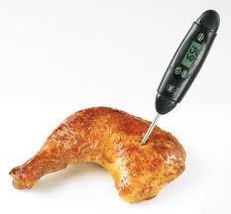
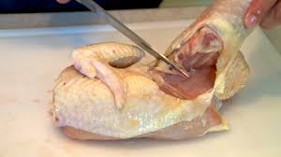
Cooking Rules
For chicken in general
Should reach an internal temperature of 165 degrees F (74 degrees C)
Should be white not pink inside
Juices should run clear

Slide 6
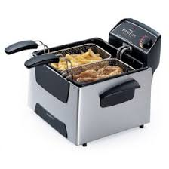
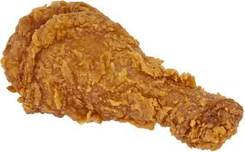
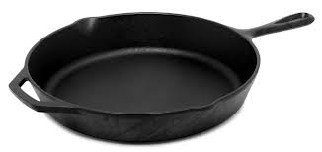
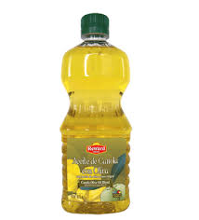
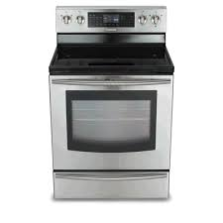
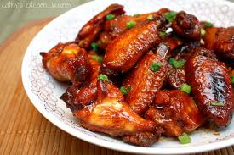
Methods of Cooking
Frying
Baking

Slide 7
Frying Safety
1. Keep water away from stove
2. Wear an apron and oven mitts
3. Know how to check if your oil is too hot or cold
4. Know how to clean up afterwards
5. Go slow when working with oil – speed and fast movements can cause spills and accidents

