Slide 1
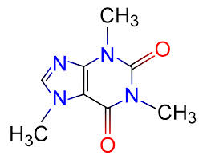
Caffeine

Slide 2
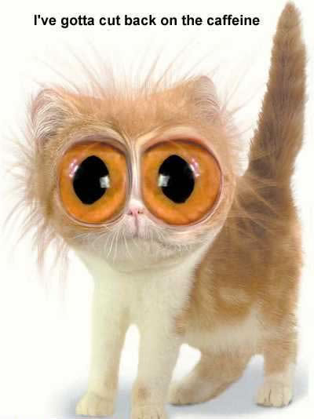
Did you know…
Caffeine is a DRUG

Slide 3
What is Caffeine found in…
Brainstorm!
Coffee
Tea
Energy drinks
Pastries
Chocolate
Coca cola
Ice cream
Soft drinks
Cakes

Slide 4
What it does…
Caffeine acts as a stimulant which increases alertness in the body
Some people are more sensitive to caffeine than others… for them caffeine can cause…
Trouble sleeping
Irritability
Nervousness
Rapid heart rate
Headaches

Slide 5
Caffeine and Pregnancy
Thought to cause mal-formations in the fetus therefore it is recommended that when pregnant, women should cut down their caffeine consumption to little or none

Slide 6
Where does it come from…

Slide 7
How much should you have?
Teenagers (13+) should NOT have more than 2.5mg of caffeine per kilogram of body weight
1kg = 2.2lbs

Slide 8
What else could happen if you drink too much?
Scientific studies showed that there was a correlation between drinking more caffeinated coffee and a decrease in bone density

Slide 9
Coffee or Coffee Based Beverages
Beverage | Serving Size | Caffeine (mg)
Coffee, brewed | 250ml (1 cup or 8oz) | 80-179
Cappuccino or Latte | 250ml (1 cup or 8oz) | 45-148
Coffee, instant | 250ml (1 cup or 8oz) | 81-106
Espresso, brewed | 30ml (1oz) | 64-90
Decaffeinated coffee | 250ml (1 cup or 8oz) | 3-15

Slide 10
Tea and Other Beverages
Beverage | Serving Size | Caffeine (mg)
Iced Tea, sweetened | 1 can (355ml) | 22-64
Tea, leaf or bag (black) | 250ml (1 cup) | 43-50
Tea (green, oolong, white) | 250ml (1 cup) | 25-45
Decaffeinated tea | 250ml (1 cup) | 0-5
Herbal teas, all varieties | 250ml (1 cup) | 0
Energy drink, various types | 250ml (1 cup) | 80-97
Diet Cola | 1 can (355ml) | 25-50
Cola | 1 can (355ml) | 37-38

Slide 11
Alcohol

Slide 12
Did you know…
Alcohol is a DRUG!
But unlike Caffeine which is a stimulant alcohol is actually an DEPRESSANT

Slide 13
Lots of different types…
Beer
Spirits
Wine
Ciders

Slide 14
Effects of Alcohol
Blurs vision
Slurs speech
Lowers inhibitions
Slows motor control
Slows brain processing speed

Slide 15
Affects of Alcohol
Appearance
Alcohol dehydrates skin and can cause rosacea
Bloatedness
Cause face and stomach to puff
Toxins help build cellulite

Slide 16
When you have a drink… SAFETY FIRST
1. Hold on to your cup – you never know if someone might slip something in it
2. Plan on how you will get home – don’t drink and drive

Slide 17
Negative Effects…
If you consume too much…
Alcohol poisoning
Slow down brain function
Irritate stomach
Effect heartbeat and breathing
Dehydration
Lower body temperature
Lower blood sugar levels
Hangovers
Liver damage

Slide 18
If you see someone with alcohol poisoning
1. try to keep them awake and sitting upright
2. give them some water, if they can keep it down
3. if they pass out, lie them on their side (in recovery position) not on the back or face down
4. keep them warm
5. stay with them and monitor symptoms until help comes

Slide 19
Alcohol… continued…
Alcohol is 7kcal/g
So it is what is known as “EMPTY CALORIES”
Fat 9kal/g
Carbohydrates 4kcal/g
Protein is 4kcal/g

Slide 20
Alcoholism
Men = should not exceed 3-4 units of alcohol a day (pint and a half of beer)
Women = should not exceed 2-3 units of alcohol a day (pint of beer)
This should not exceed more than 2 times per week

Slide 21
Alcohol and Pregnancy
The acohol crosses into the babies blood and can damage the nervous system
During breastfeeding alcohol can get into the mothers milk and harm the baby as well

Slide 22
FAS = Fetal Alchol Symptom
Liver cant process alcohol
Increase blood alcohol volume
Not enough oxygen in blood getting to brain

Slide 23
So why do people do it…
It is a “social lubricant” that makes people feel more at ease in social situations
It is important to learn how your body acts and reacts to alcohol and learn your tolerances in order to not embarrass yourself and stay safe

