Slide 1
Appetizers
A small morsel of food generally served as the first course of a meal to stimulate the appetite for more or heavier foods to follow

Slide 2
Classifications:
1. Cocktails
2. Hors d’oeuvres
3. Canapes
4. Relishes
5. Dips
6. Petit Salads
7. Soups and Consummes

Slide 3
What Makes a Good Appie and Why?
Not too filling – room for big meal
Has to taste good
Snack like item
Small
Cant be too messy

Slide 4
What are your favourite appies?
South west potato skin
Spinach dip
Calamari
Hot chicken wings
Samosa
Thai chicken bits
Garlic cheese bread
Nachos
Yam fries

Slide 5
What goes on when you have appies?
Chatting – moving around
Special occasions – birthdays, parties
Restaurants – sitting down

Slide 6
When to Have Appies…
When guests arrive at party and there is time before a meal is served
At a wedding before the dinner – cocktail hour
At a restaurant to whet your appetite
As the food for a party or celebration – commonly potlucks or celebrations

Slide 7
Styles of Appies…
Buffet Style
Seated Meal Style
Wandering Waiters

Slide 8
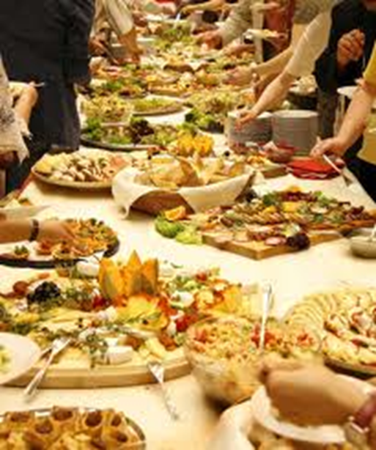
Buffet Style
Benefits:
Have all selections out for guests to see and take what they desire
Easy for large groups, parties and potlucks
Negatives:
Could be unsanitary
Cannot determine who eats what amount
Don’t always know the ingredients
At restaurants tend to be “all you can eat” which often promotes overeating and overweight-ness

Slide 9
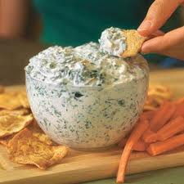
Buffet Style Dips…
If you have dips the sauce should be spoon onto your plate for dipping – DO NOT dip your food into the main serving bowl unless plates are not provided – if that’s the case NO double dipping

Slide 10
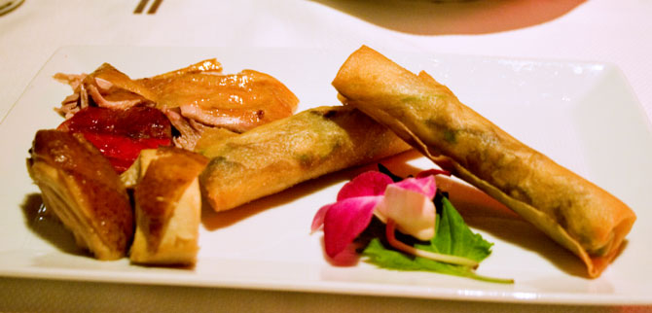
Seated Meal Style
Benefits:
Easy for the consumer
Can have what you want
Negatives:
Need waiters to serve
Typically more expensive
Don’t get the variety of buffet

Slide 11
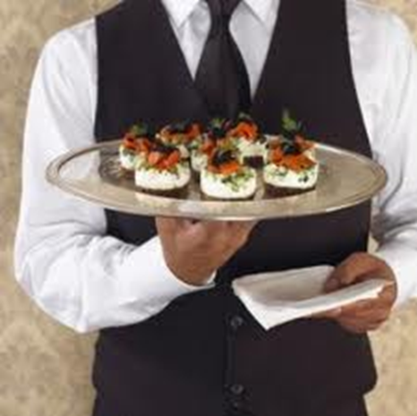
Wandering Waiters Style
Benefits:
Looks classy
Not as unsanitary as a buffet style
Foods can be kept hot or cold better
Negatives:
Potentially expensive
Can’t necessarily find a waiter or get any of the foods offered
Smaller portions on trays so food is not always readily available

Slide 12
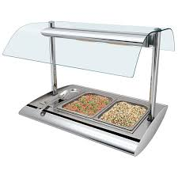
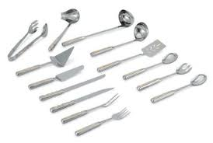
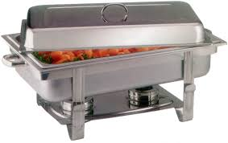
Buffet Safety
At restaurants
Have warming or cooling trays
Food should not be out more than 2 hours
Have sneeze guards
Have utensils to serve the food
At parties
Don’t serve food that goes bad quickly at room temperature
http://www.youtube.com/watch?v=TS_s_NEq9-k

Slide 13
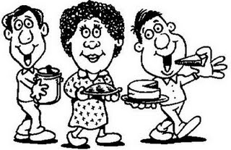
Potlucks
Definition:
A gathering of people where each person or group may contribute a dish of food prepared by that person or group to be shared among the gathering
Benefits:
Not as much work for the host/hostess
Everyone takes home own leftovers and does their own clean up

Slide 14
Class Project
We are going to plan a party for our class
Each group is going to research an appetizer they wish to bring to the party
We need to select a hostess or host for the party
Whoever comes up with the best method to choose who brings what to the party will get this role – what if everyone brings dip?
Prepare the appetizer for 30 people

Slide 15
Party Setup
What needs to be considered?
Décor? What kind of party is this? Is there a theme?
How food gets served?
Where to put food?
How will guests eat? Mingle?
Are there planned activities?

